Slide 1
Economy, Divine and Human
Professor Kirk Doran
Lecture 9: Wednesday, September 20, 2023
The Catholic Church, new institutions, and the market

Slide 2
Outline
Prayer
Review
True Individualism vs. Moderate Individualism
Market Integration and Impersonal Prosociality
The Oromo, markets, & voluntary associations
Interpersonal vs. Impersonal prosociality
What happens when there’s no big hug?
Next Steps

Slide 3
Review
We’ve argued that our four economic patterns are the only possible patterns, contingent on economic activity happening in the first place.
We’ve argued that moderate individualism is, in part, a psychological package of various traits, now so common in what Henrich calls WEIRD societies that they were long thought to be universal.
We’ve argued that these traits seem to be in a positive feedback loop with the contingencies for stably instantiating our four economic patterns.
We’ve argued that the Catholic Church’s MFP dissolved the kinship norms and psychologies which are opposed to moderate individualism.

Slide 4
Review
But why would we get moderate individualism out of the dissolving kinship norms?
Why wouldn’t we get extreme individualism?
And what role did new institutions (such as the manorial system and the reformed monasteries which we ended with last time) play in answering this question?
To find out, let’s continue!!!

Slide 5
True Individualism vs. Moderate Individualism
In the Summer of 1994, Joseph Henrich spent a few months traveling by dugout canoe among various remote Matsigenka communities while conducting anthropological fieldwork on how markets shape farming practices.
The Matsigenka are highly independent slash-and-burn farmers who traditionally lived in nuclear families or small family hamlets scattered throughout a region of the Peruvian Amazon.
During this first summer of research, he was repeatedly struck by how these communities, despite their small size, struggled to work together on village projects.

Slide 6
True Individualism vs. Moderate Individualism
People cooperated easily with their extended families and sometimes with nearby households, but free-riding prevailed when it came time to build village schools, fix the community’s rice processor, or even trim the common grass field.
During the subsequent year, while puzzling over these observations, he learned about an experiment called the Ultimatum Game.
Immediately, he planned to try it out on the Matsigenka the following summer.

Slide 7
True Individualism vs. Moderate Individualism
In the Ultimatum Game (UG), two individuals are anonymously paired and must divide a sum of real money – the stake – between them.
Say the stake is $100.
The first player – the proposer – must make an offer between zero and the full amount ($100) to the second player – the receiver.
Suppose the proposer offers $10 out of the $100 to the receiver.
The receiver must then decide whether to accept or reject this offer.
If she accepts, she gets the amount offered ($10 in this example), and the proposer gets the remainder ($90).
If the receiver rejects, both players get zero.
The interaction is anonymous and one-shot, meaning that the pair will never interact again and won’t learn each other’s identity.

Slide 8
True Individualism vs. Moderate Individualism
If people have individual utility functions based purely on their own consumption (as proposed in mid-20th century theoretical economics), and we apply late 20th century game theory to these utility functions, we get a very clear prediction of what people will do (and ought to do!) in the Ultimatum Game:
In the UG, as long as the proposer offers more than zero, receivers face a choice between some cash if they accept, and nothing if they reject.
Faced with this simple choice, income-maximizing receivers should always accept non-zero offers.
Proposers, realizing the stark choice faced by receivers, should make the smallest positive offer they can.
Thus, if we put $100 on the line and limit people to making offers in $10 increments, this theory predicts that proposers should offer receivers only $10 out of the $100.

Slide 9
True Individualism vs. Moderate Individualism
In societies heavily influenced by the historical Christian Church (what Henrich calls WEIRD societies), most adults over about age 25 offer half ($50).
Offers of less than 40 percent ($40) are frequently rejected.
The average offer is usually about 48 percent of the stake.
In these populations, following standard game theory is a bad move.
WEIRD people reveal strong inclinations for equal offers in the Ultimatum Game.

Slide 10
True Individualism vs. Moderate Individualism
What happened when Henrich ran the UG among the Matsigenka?
The stakes were 20 Peruvian soles (2 days’ earnings in labor market).
Most Matsigenka proposers offered 3 soles (15%).
Several people offered 5 soles, and a few offered 10 soles.
Overall, the mean offer was 26% of the 20 sole stake.
All but one of these low offers were immediately accepted.

Slide 11
True Individualism vs. Moderate Individualism
What was most striking wasn’t even these statistical results – it was the interviews he did with players afterwards.
Matisgenka receivers didn’t see proposers as obligated to “be fair” and to give half the money.
Rather, they seemed almost grateful that their anonymous partner decided to give them anything.
They couldn’t understand why someone would reject free money.
This, in part, explained why he had so much trouble teaching them the rules of the game.
The idea of rejecting any free money seemed so silly that players assumed they were misunderstanding my instructions.

Slide 12
True Individualism vs. Moderate Individualism
In retrospect, after a quarter of a century of research by Henrich and others on this topic, these early experimental findings seem obvious.
What we are seeing in Matsigenka behavior was merely a reflection of their social norms and lifeways, as what we see in WEIRD behavior is for its social norms.
Matisgenka lack institutions for solving large-scale cooperative dilemmas, establishing command and control, and scaling up their sociopolitical complexity.

Slide 13
True Individualism vs. Moderate Individualism
Instead, they’re true individualists.
Their internalized motivations are calibrated to navigate the family-level institutions of their societies, so there’s no reason to expect them to make equal offers to anonymous others or strangers, or to give up free money to punish locally sensible behaviors by proposers.
This is what psychological individualism looks like without the influence of potent impersonal norms, competitive markets, and prosocial religions.

Slide 14
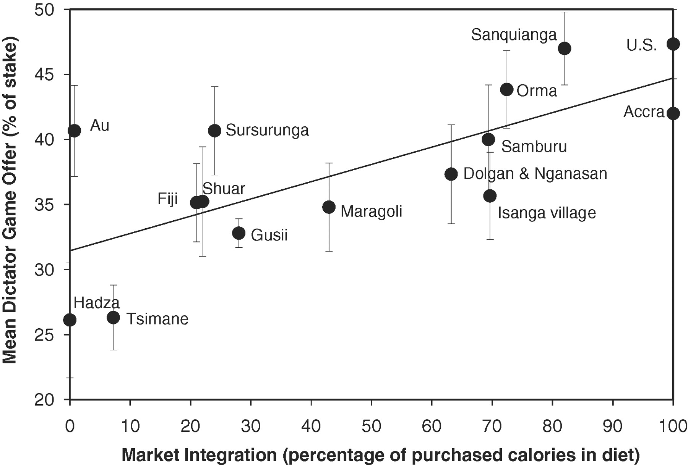
Market Integration & Impersonal Prosociality

Slide 15
Market Integration & Impersonal Prosociality
These patterns hold across all three experiments (UG, Dictator Game, 3rd-party punishment game) regardless of the effects of income, wealth, community size, education, and other demographic variables.
Incidentally, of all the variables analyzed along with market integration, there was only one other that was consistently correlated with higher offers. Can you guess what it might be?

Slide 16
Market Integration & Impersonal Prosociality
These patterns hold across all three experiments (UG, Dictator Game, 3rd-party punishment game) regardless of the effects of income, wealth, community size, education, and other demographic variables.
Incidentally, of all the variables analyzed along with market integration, there was only one other that was consistently correlated with higher offers. Can you guess what it might be?
Participants who reported adherence to a world religion, with a Big God and supernatural punishment, offered 6 to 10 percentile points higher in both DG and UG.

Slide 17
Market Integration & Impersonal Prosociality
Why would individuals from more market-oriented communities reveal stronger inclinations towards impersonal fairness in these experiments?
Well functioning impersonal markets, in which strangers freely engage in competitive exchange, caring primarily about commutative justice, demand what are called market norms.
Market norms establish the standards for judging oneself and others in impersonal transactions and lead to the internalization of motivations for trust, fairness, and cooperation with strangers and anonymous others.

Slide 18
Market Integration & Impersonal Prosociality
These are the social norms usually tapped by economic experiments, with their salient cues of money and anonymity.
In a world lacking intensive kin-based institutions, where people depend on well-functioning commercial markets for nearly everything, individuals succeed in part by cultivating a habit of impartial fairness, honesty, and cooperation with acquaintances, strangers, students, and clients.
Such market norms specify how to behave when you don’t have a relationship with someone or know each other’s family, friends, social status or caste.
Such norms allow people to readily engage in a wide range of mutually beneficial transactions with just about anyone.

Slide 19
Market Integration & Impersonal Prosociality
Market norms encourage an approach orientation and a positive-sum worldview but demand sensitivity to the intentions and actions of others.
Fairness is met with fairness, trust with trust, and cooperation with cooperations, all judged according to normative standards.
Violations of market norms by one’s own partners or third parties are met with a willingness to engage in costly norm enforcement.

Slide 20
Market Integration & Impersonal Prosociality
Of course, markets also favor a competitive and calculating mind-set – people want to win, but they won’t get complete respect unless they win while following the norms and agreed-upon rules.
The greatest respect goes to those who succeed by their own talents and hard work while still being fair, honest, and impartial.
This is a peculiar standard, since it devalues family connections, personal relationships, tribal parochialism, and clan alliances, which have all been standard over much of human history.
In most times and places, in-group loyalty and family honor have trumped impartial fairness with strangers.

Slide 21
Market Integration & Impersonal Prosociality
So far, we’ve seen a sturdy and reliable correlation between market integration and impersonal fairness.
This relationship could be due to more fair-minded people moving into market-integrated communities.
The key question is whether greater market integration actually causes greater impersonal prosociality.
That is, do markets alter people’s motivations – via the internalization of market norms – so that they are more prosocial with strangers and anonymous partners?

Slide 22
The Oromo, markets, & voluntary associations
Living on the northern slopes of Ethiopia’s Bale Mountains, the Oromo engage in cattle herding, subsistence farming, and forest gathering.
To assess their impersonal prosociality, the economist Devesh Rustagi administered a simple experiment in which individuals were placed into a one-shot cooperative dilemma with an anonymous partner.
Participants, after receiving nearly a day’s wage in the form of 6 birr bills, could contribute any number of these bills to a “common project” with their partner.
Cash contributed to the project by either partner was increased by 50% and then split equally between the pair.

Slide 23
The Oromo, markets, & voluntary associations
This meant that each player took home half of the total project money plus whatever they’d kept for themselves.
Here, pairs make the most money if both players contribute the maximum – all 6 birr, in this case.
Individuals, however, make the most if they contribute nothing and free-ride on the contributions of their partner – this is what game theory predicts will occur.

Slide 24
The Oromo, markets, & voluntary associations
Each Oromo participant faced two versions of this game.
First, players stated how much they’d contribute – from 0 to 6 birr – to the common project without knowing the amount contributed by their partners.
Then each player also committed to how much they’d contribute to the common project for each of the possible contributions that their partner could make.
In other words, players had to commit to how much they’d contribute if their partner gave 0,1,2,3,4,5, or all 6 birr to the their joint project.

Slide 25
The Oromo, markets, & voluntary associations
This approach allowed Devesh to assign participants to categories such as “altruist” or “free rider” and to calculate their propensity to conditionally cooperate with their partner.
Altruists contributed a lot regardless of how much their partner contributed.
Altruists were rare – only about 2% of the 734 participants.
By contrast, free riders contributed very little to the common project and were unresponsive to higher cooperative contributions from their partners.
Free riders were 10 percent of the population.

Slide 26
The Oromo, markets, & voluntary associations
For everyone else (88%), Devesh calculated how much their partners’ contributions influenced their own contributions.
Participants who matched their partners’ higher contributions in lockstep got a score of 100 – they were perfectly conditionally cooperative.
Those whose contributions were unconnected to their partner’s contribution got a score of zero.
It’s also possible to get negative scores, if you tend to give less when your partner gives more.
So, this measure of people’s propensity for conditional cooperation could theoretically range from -100 to +100.

Slide 27
The Oromo, markets, & voluntary associations
Across 53 Oromo communities, we can see that individuals from more market-integrated places were much more conditionally cooperative than those from less-market integrated places.
Market-integration was measured by how long it took to travel from one’s community to one of the four towns in the region that periodically hold “market days”.
Market days provide the only opportunities for Oromo to sell and buy a wide range of goods, including local products like butter, honey, and bamboo as well as imports like razor blades, candles, and rubber boots.

Slide 28
The Oromo, markets, & voluntary associations
These events attract thousands of people from diverse communities and thus create a dizzying array of transactions.
Not surprisingly, the travel time to each of these towns is correlated with the frequency with which people travel to buy and sell at the markets.
The closest communities, with travel times of less than two hours, all had average propensities for conditional cooperation above 60.
By contrast, when people had to walk for four or more hours to get to the market, the average propensity for conditional cooperation dropped to less than 20.
Overall, for every hour closer to the market, people’s propensity for conditional cooperation with an anonymous partner increased by 15.

Slide 29
The Oromo, markets, & voluntary associations
This research strongly suggests that greater market integration does indeed foster greater impersonal prosociality.
Here’s why.
The geographic location of Oromo clans, and thus their travel time to local markets, is determined by local customs related to patrilineal inheritance, communal ownership, and land use rights that preceded the development of these commercial centers.
Because these customs effectively tie individuals ot their lands, the relationship between market integration and cooperation can’t be due to prosocial Oromo moving closer to markets.

Slide 30
The Oromo, markets, & voluntary associations
As for the market towns, their locations were determined largely by geographic and military concerns that had little to do with the Oromo.
Moreover, the relationship between market proximity and conditional cooperation held even after Devesh statistically accounted for the effects of a wide range of factors like wealth, inequality, community size, and literacy.
The implication is that Oromo who just happened to grow up near market towns more deeply internalized market norms, which manifests in greater impersonal prosociality in these one-shot, anonymous experiments.

Slide 31
The Oromo, markets, & voluntary associations
Devesh’s Oromo study is particularly cool because it allows us to take the next crucial step: it demonstrates that greater impersonal prosociality – internalized market norms – can lay the psychological foundations for constructing more effective voluntary organizations based on formalized agreements and rules.
Let’s see how.

Slide 32
The Oromo, markets, & voluntary associations
As part of a large conservation program, these Oromo communities were invited to form voluntary organizations – cooperatives – aimed at limiting deforestation by actively managing logging and grazing.
Detailed analyses reveal that the stronger a community’s propensity toward conditional cooperation (as assessed in Devesh’s experiments), the more likely these communities were to form cooperative associations that created explicit rules to regulate timber extraction and pasturing.
Specifically, increasing a community’s propensity for conditional cooperation by 20 on our scale raises its likelihood of forming a new cooperative associate by 30 to 40 percentile points.

Slide 33
The Oromo, markets, & voluntary associations
Did forming cooperative associations actually cash out in greater long-term benefits?
It did.
The forests surrounding these Oromo communities were assessed every five years to measure local deforestation rates and gauge the effectiveness of forest management.
These assessments were based on objective measures, such as the circumference of the trees.
The data show that both the formation of cooperative associations and the local propensity for conditional cooperation promoted healthier forests.
One reason why this occurred is that the stronger people’s inclinations toward conditional cooperation, the more time they spent monitoring the common forest and catching free riders who were cutting down young trees or overgrazing common pastures – that is, they engaged in more third-party norm enforcement.

Slide 34
The Oromo, markets, & voluntary associations
Let’s synthesize the key insights from the Oromo.

Slide 35
The Oromo, markets, & voluntary associations
Formal institutions (explicit rules, monitoring, and sanctions)
Public goods and common resources (forest management)
Market Integration (market proximity)
Impersonal prosociality (conditional cooperation)
Formation of voluntary associations

Slide 36
Interpersonal vs. Impersonal prosociality
Surprised?
The notion that market integration is associated with greater fairness or cooperation is jarring to many WEIRD people.
Aren’t people from small-scale societies and rural villages highly prosocial, cooperative, and generous?
Don’t markets sometimes make people individualistic and calculating?
Yes, to both questions.

Slide 37
Interpersonal vs. Impersonal prosociality
To illuminate this seeming contradiction, we must distinguish interpersonal prosociality from impersonal prosociality.
The kindness and generosity found in many small-scale societies and rural villages are rooted in kin-based institutions that focus on nurturing and sustaining enduring webs of interpersonal relationships.
It’s both impressive and beautiful, but this interpersonal prosociality is about relationship-specific kindness, warmth, reciprocity, and – sometimes – unconditional generosity as well as authority and deference.
It’s focused on the in-group members and their networks.
If you’re in the group or network, it can feel like a long and comforting hug.

Slide 38
Interpersonal vs. Impersonal prosociality
By contrast, economic experiments typically tap market norms that prescribe fair dealing and honesty with strangers or anonymous others, especially in exchange (commutative justice) or in the management of public goods and common resources necessary for economic flourishing.
This impersonal prosociality is about fairness principles, impartiality, honesty, and conditional cooperation in situations and contexts where interpersonal connections and in-group membership are deemed unnecessary or even irrelevant.
In worlds dominated by impersonal contexts, people depend on anonymous markets, insurance, courts, and other impersonal institutions and instead of large relationship networks and personal ties.

Slide 39
Interpersonal vs. Impersonal prosociality
Impersonal markets can thus have dual effects on our social psychology.
They simultaneously reduce our interpersonal prosciality within our in-groups and increase our impersonal prosociality with acquaintances and strangers.
“Commerce is a cure for the most destructive prejudices; for it is almost a general rule that wherever manners are gentle there is commerce; and wherever there is commerce, manners are gentle” – Montesqieu (1749), The Spirit of the Laws

Slide 41
What happens when there is no big hug?
Of course, this moderate individualism is clearly only stable when it generates (and is supported by) voluntary associations that ensure commutative justice in exchanges, as well as the support of necessary common resources and public goods, to say nothing of other human necessities such as families, friends, and religion.
Karl Marx and others began to consider what immoderately commercialized societies had lost (that nice hug I mentioned), and how the expanding social sphere governed by market norms changed our lives and psychology.

Slide 42
What happens when there is no big hug?
The replacement of dense networks of interpersonal relationships and socially embedded exchange with impersonal institutions has sometimes led to alienation, exploitation, and commodification.
Unfortunately, Marx’s answer, Classical Socialism, was incapable of supporting the needs not being met by commercialization, let alone the needs that were being met by it (sustainable economic patterns!).
So, the Church responded with the introduction of Catholic Social Teaching, starting with the encyclical letter Rerum Novarum in 1891 by Pope Leo XIII

Slide 43
Next Steps
We’ve seen how moderate individualism and impersonal prosociality are causally related to the necessary conditions for our four economic patterns.
This causal relationship is mediated through voluntary associations, informal institutions, and social norms.
The Catholic Church’s MFP was influential in dissolving the kinship norms and associated psychologies which limited the necessary conditions for our four economic patterns.
By the time of industrialization, something had gone wrong with the equilibrium, and there seemed to be an increase in alienation and exploitation.

Slide 44
Next Steps
There were two answers to what to do that were especially prominent: Marx’s answer, and Pope Leo XII’s answer.
Marx’s answer correctly noted a connection between religion and the continued operation of markets; he recommended attacking both!
The Catholic Church’s answer also correctly noted a connection between religion and the continued operation of markets; but it recommended supporting both by doubling down on voluntary associations and proposing a new type of justice for how to harmonize them with each other: social justice!

Slide 45
Next Steps
Much of what we will do later in the course will be to analyze the Church’s response: social justice!
But, before we get there, we need to do two things:
(1) See what happens when we attack markets and the Church simultaneously, by studying the empirical patterns of Classical Socialism.
(2) Learn some Thomistic Philosophy and Theology, which formed the theoretical foundation for Rerum Novarum and at least the first 50 years of Catholic Social Teaching!

