Slide 1
Economy, Divine and Human
Professor Kirk Doran
Lecture 7: Wednesday, September 13, 2023
The Evolution of Societies and Psychologies

Slide 2
Outline
(1) Prayer
(2) Lives Deeply Affected by Economic Patterns
(3) What is needed?
(4) Who are you?
(5) Individualism
(6) Kin-based Societies
(7) Highly Individualistic Societies
(8) Moderate Individualism, Economic Patterns, and Psychology
(9) Social Evolution, Kinship Norms, and the Church
(10) Question: How could the Church possibly affect this?
(11) Primer on how to Read Saint Thomas!!!

Slide 3
Lives Deeply Affected by Economic Patterns
We’ve studied the existence of contingent economic patterns.

Slide 4
Lives Deeply Affected by Economic Patterns
We’ve studied the existence of contingent economic patterns.
We need to dig deeper into what the contingencies are.

Slide 5
Lives Deeply Affected by Economic Patterns
We’ve studied the existence of contingent economic patterns.
We need to dig deeper into what the contingencies are.
What is necessary for the sustainable instantiation of these patterns in an actual society?

Slide 6
Lives Deeply Affected by Economic Patterns
We’ve studied the existence of contingent economic patterns.
We need to dig deeper into what the contingencies are.
What is necessary for the sustainable instantiation of these patterns in an actual society?
For example, in any society where people occasionally trade, market equilibration will occur whenever trading occurs.

Slide 7
Lives Deeply Affected by Economic Patterns
We’ve studied the existence of contingent economic patterns.
We need to dig deeper into what the contingencies are.
What is necessary for the sustainable instantiation of these patterns in an actual society?
For example, in any society where people occasionally trade, market equilibration will occur whenever trading occurs.
But, what makes a society do so much trade and dissemination of all four types of goods that market forces and other economic patterns predictably affect who does what with whom, where and when?

Slide 8
Lives Deeply Affected by Economic Patterns
We’ve studied the existence of contingent economic patterns.
We need to dig deeper into what the contingencies are.
What is necessary for the sustainable instantiation of these patterns in an actual society?
For example, in any society where people occasionally trade, market equilibration will occur whenever trading occurs.
But, what makes a society do so much trade and dissemination of all four types of goods that market forces and other economic patterns predictably affect who does what with whom, where and when?
Let’s find out!

Slide 9
What is needed?
For example, for the market patterns in trading private goods to stably exist across a wide variety of private goods, people need to be willing to make binary exchanges frequently.

Slide 10
What is needed?
For example, for the market patterns in trading private goods to stably exist across a wide variety of private goods, people need to be willing to make binary exchanges frequently.
They need to think about commutative justice in those binary exchanges.

Slide 11
What is needed?
For example, for the market patterns in trading private goods to stably exist across a wide variety of private goods, people need to be willing to make binary exchanges frequently.
They need to think about commutative justice in those binary exchanges.
They need to have a sense that their property is their own.

Slide 12
What is needed?
For example, for the market patterns in trading private goods to stably exist across a wide variety of private goods, people need to be willing to make binary exchanges frequently.
They need to think about commutative justice in those binary exchanges.
They need to have a sense that their property is their own.
And they need to have a basic trust among each other: that most people aren’t lying about what they have or what they are offering.

Slide 13
What is needed?
Likewise, the other patterns we’ve covered, such as knowledge inducing growth, all depend on their own sets of contingencies.

Slide 14
What is needed?
Likewise, the other patterns we’ve covered, such as knowledge inducing growth, all depend on their own sets of contingencies.
It turns out that the Catholic Church was intimately related to the development of psychologies, cultures, and institutions that instantiated these contingencies.

Slide 15
What is needed?
Likewise, the other patterns we’ve covered, such as knowledge inducing growth, all depend on their own sets of contingencies.
It turns out that the Catholic Church was intimately related to the development of psychologies, cultures, and institutions that instantiated these contingencies.
That is the theme of the next several lectures!

Slide 16
Who are you?
Try completing this sentence in 10 different ways:
I am ________________________________

Slide 17
Who are you?
If you are like most undergraduates, you probably answered with words like:
“curious”
“passionate”
“a student”
“a business major”
“a runner”
“a singer”

Slide 18
Who are you?
You were probably less inclined to respond with things like:
“Josh’s brother”
“Mary’s daughter”
“David’s friend”

Slide 19
Who are you?
You were probably less inclined to respond with things like:
“Josh’s brother”
“Mary’s daughter”
“David’s friend”
Even though those are equally true and potentially more central to your life.

Slide 20
Personal Identity across Populations

Slide 21
Individualism
It looks like undergrads, wherever they are from, focus on personal attributes, abilities, and aspirations, rather than roles and relationships.
Complimenting this work, many similar psychological studies allow us to compare people from around the world to each other, and also, within each country, to compare undergraduates to others.
Focusing on one’s attributes and achievements over one’s roles and relationships is a key element in a psychological package that we’ll clump together as individualism.

Slide 22
Individualism
Individualism is best thought of as a psychological cluster that allows people to better navigate literate and exchange-heavy social worlds by calibrating their perceptions, attention, judgement, and emotions.
Most populations reveal psychological packages that similarly “fit” their societies’ institutions, technologies, environments, and languages.

Slide 23
Kin-based societies
To understand individualism, let’s start at the other end of the spectrum.
Throughout most of human history, people grew up enmeshed in dense family networks that knitted together distant cousins and in-laws.
In these regulated-relational worlds, people’s survival, identity, security, marriages, and success depended on the health and prosperity of kin-based networks, which often formed discrete institutions known as clans, lineages, houses, or tribes.

Slide 24
Kin-based societies
This is the world of the Maasai and Samburu.
Within these enduring networks, everyone is endowed with an extensive array of inherited obligations, responsibilities, and privileges in relation to others in a dense social web.
For example, a man could be obligated to avenge the murder of one type of second cousin (through his paternal great-grandfather).
He could be privileged to marry his mother’s brother’s daughters but tabooed from marrying strangers.
He could be responsible for performing expensive rituals to honor his ancestors, who will give bad luck to his entire lineage if he’s negligent

Slide 25
Kin-based societies
Behavior is highly constrained by context and the types of relationships involved.
The social norms that govern these relationships, which collectively form what we’ll call kin-based institutions, constrain people from searching widely for friends, business partners, or spouses.
Instead, they channel people’s investments into a distinct and largely inherited in-group.

Slide 26
Kin-based societies
Many kin-based institutions not only influence inheritance and the residence of newly married couples, they also create communal ownership of property (e.g., land is owned by the clan) and shared liability for criminal acts among members (e.g., fathers can be imprisoned for their sons’ crimes).

Slide 27
Kin-based societies
This social interdependence breeds emotional interdependence, leading people to strongly identify with their in-groups and to make sharp in-group vs. out-group distinctions based on social interconnections.
In fact, in this world, though you may not know some of your distant cousins or fellow tribal members who are three or four relationship links removed, they will remain in-group members as long as they are connected to you through family ties.
By contrast, otherwise familiar faces may remain, effectively, strangers if you cannot link to them through your dense, durable social ties.

Slide 28
Kin-based societies
Success and respect in this world hinge on adroitly navigating these kin-based institutions. This often means:

Slide 29
Kin-based societies
Success and respect in this world hinge on adroitly navigating these kin-based institutions. This often means:
(1) conforming to fellow in-group members

Slide 30
Kin-based societies
Success and respect in this world hinge on adroitly navigating these kin-based institutions. This often means:
(1) conforming to fellow in-group members
(2) deferring to authorities like elders or sages

Slide 31
Kin-based societies
Success and respect in this world hinge on adroitly navigating these kin-based institutions. This often means:
(1) conforming to fellow in-group members
(2) deferring to authorities like elders or sages
(3) policing the behavior of those close to you (but not strangers)

Slide 32
Kin-based societies
Success and respect in this world hinge on adroitly navigating these kin-based institutions. This often means:
(1) conforming to fellow in-group members
(2) deferring to authorities like elders or sages
(3) policing the behavior of those close to you (but not strangers)
(4) sharply distinguishing your in-group from everyone else, and

Slide 33
Kin-based societies
Success and respect in this world hinge on adroitly navigating these kin-based institutions. This often means:
(1) conforming to fellow in-group members
(2) deferring to authorities like elders or sages
(3) policing the behavior of those close to you (but not strangers)
(4) sharply distinguishing your in-group from everyone else, and
(5) promoting your network’s collective success whenever possible.

Slide 34
Kin-based societies
Further, because of the numerous obligations, responsibilities, and constraints imposed by custom, people’s motivations tend not to be “approach-oriented,” aimed at starting new relationships or meeting strangers.
Instead, people become “avoidance-oriented” to minimize their changes of appearing deviant, fomenting disharmony, or bringing shame on themselves or others.
That’s one extreme: now, let’s contrast that with the other – extremely individualistic – end of the spectrum.

Slide 35
Highly Individualistic Societies
Imagine the psychology needed to navigate a world with few inherited ties in which success and respect depend on:

Slide 36
Highly Individualistic Societies
Imagine the psychology needed to navigate a world with few inherited ties in which success and respect depend on:
(1) honoring one’s own special attributes

Slide 37
Highly Individualistic Societies
Imagine the psychology needed to navigate a world with few inherited ties in which success and respect depend on:
(1) honoring one’s own special attributes
(2) attracting friends, mates, and business partners with those attributes

Slide 38
Highly Individualistic Societies
Imagine the psychology needed to navigate a world with few inherited ties in which success and respect depend on:
(1) honoring one’s own special attributes
(2) attracting friends, mates, and business partners with those attributes
(3) sustaining relationships with them where the endurance of the relationship (in the case of friends and business partners) or the flourishing of the relationship (in the case of marriage) happens by investments made by the free choice of the individuals in question

Slide 39
Highly Individualistic Societies
In this world, everyone is building relationships, and doing their best to make them high enough quality that they will endure.
People have a few permanent ties, a moderate number of long-term friends, and many ephemeral friends, colleagues, and acquaintances.
In adapting psychologically to this world, people come to see themselves and others as, in part, independent agents defined by a unique or special set of talents (e.g., writer), interests (e.g., quilting), aspirations (e.g., making law partner), virtues (e.g., fairness), and principles (e.g., ‘no one is above the law’).

Slide 40
Highly Individualistic Societies
These can be enhanced or accentuated if a person joins a like-minded group.
One’s reputation with others, and with themselves (self-esteem), is shaped primarily by their own individual attributes, accomplishments and investments, not by nourishing an enduring web of inherited ties that are governed by a complex set of relationship-specific social norms.

Slide 41
Moderate Individualism & Economic Patterns
It’s easy to see how a society full of people with at least some individualism may play a role in instantiating stable economic patterns.
Moderate individualism may be more likely than kin-based institutions to induce interactions with strangers, a willingness to exchange, etc.
An extreme amount of individualism may prevent investment in public goods or preservation of common resources, and we already learned that these are both necessary for societies and economic patterns to endure.
But it’s plausible that moderate individualism would make the stable instantiation of the four main economic patterns more likely.

Slide 42
Highly Individualistic Psychology
Psychological Outcomes associated with Economic Activity, and hence many Economic Patterns:
Individualism and Personal Motivation | -- Self-focus, self-esteem, and self-enhancement -- Low conformity and deference -- Patience, self-regulation, -- Time thrift and hard work -- Desire for control and love of choice
Impersonal Prosociality (and Related Worldviews) | -- Impartial principles over contextual particularism -- Trust, fairness, honesty, and cooperation with anonymous others, strangers, and impersonal institutions -- muted concern for revenge but willingness to punish third parties
Perceptual and Cognitive Abilities and Biases | -- analytical over holistic thinking -- endowment effect

Slide 43
How could the Church be involved?
How might the Catholic Church have been involved in developing societies where such a psychology would be common?
To find out, let’s consider the raw ingredients in shaping a society.
If the Church has a tendency of getting involved in those raw ingredients, then plausibly it may have a tendency of shaping a society in this way.

Slide 44
Evolving Societies
Human Societies are stitched together by culturally transmitted social norms that cluster into institutions.
For example, marriage institutions around the world are composed of social norms that regulate things like who individuals can marry (e.g., not stepchildren), how many spouses they can have (e.g., one at a time), and where the married couple lives after marriage (e.g., with the husband’s family).
We’re talking about informal institutions: social norms

Slide 45
Social Norms
Social norms arise directly from cultural learning and social interaction – that is, via cultural evolution.
Just as we can learn the proper way to hunt, we can culturally acquire certain social behaviors as well as the standards for judging others on those behaviors.
Many social norms prescribe or proscribe certain behaviors, and violation of them incurs the wrath of the community.
Other norms are social standards that, if exceeded, inspire affirmation or respect from the community.

Slide 46
Kinship norms
Our most fundamental institutions are rooted in kinship.
Humans possess innate altruistic inclinations toward our close genetic relatives – kin altruism.
This evolved aspect of our psychology explains why parents love their babies and siblings usually stick together.
Kinship norms not only reinforce these powerful motivations, by creating social expectations in communities (e.g., siblings should help each other), but extend these expectations outward from the nuclear family to more distant relatives, and even to strangers.

Slide 47
Kinship norms
When more distant relatives get called “mom,” “dad,” “brother, “ and “sister”, sets of norms and perhaps even some internalized motivations about the relationships get stretched outward along with the labels, effectively pulling more distant kinfolk closer over time.

Slide 48
The key driver of kinship norms
What is the key driver of development – and change – in kinship norms?
It’s marriage!
Marriage represents the keystone institution for most – though not all – societies and may be the most primeval of human institutions.
In harnessing our pair-bonding instincts to build up larger societies and broader social networks of affines (in-laws, etc), cultural evolution has often favored lifelong marital bonds, because these bongs stitch large (and hence, successful) kin networks together.

Slide 49
Causal pathway
The kind of kinship norms that create more successful societies will eventually replace kinship norms which create less successful societies.
In turn, these kinship norms provide the foundation for a broader set of social norms and institutions.
All of these together can deeply affect the typical psychology of the people in a society.
And, finally, if the psychology of the typical person contains the right amount of moderate individualism, then. . . We get economic patterns affecting every day life!!!

Slide 50
Next steps
So, it remains to show how the Catholic Church may have influenced kinship norms.
Monogamy was already common when the Church was founded.
So, what was left for the Church to affect?
And how did the Church’s changes induce the kind of kinship norms that would eventually favor moderate individualism?
That’s what we’ll see in Lecture 8!!!

Slide 51
Antonio’s turn!
Very soon, you will have the joy and challenge of reading St. Thomas in the original English! Ha!
In any case, a primary source (translated).
Now, Antonio will help us understand how to do so!!!

Slide 52
Introduction to the Summa Theologiae

Slide 53
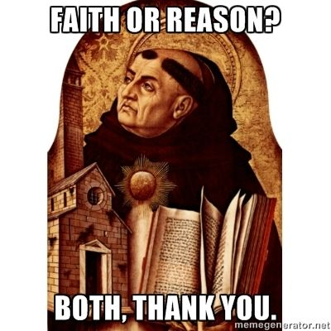
Who was Saint Thomas Aquinas?
Italian, 1225-1274
Dominican Friar, order of Preachers
Professor of Theology
Man of prayer and piety

Slide 54
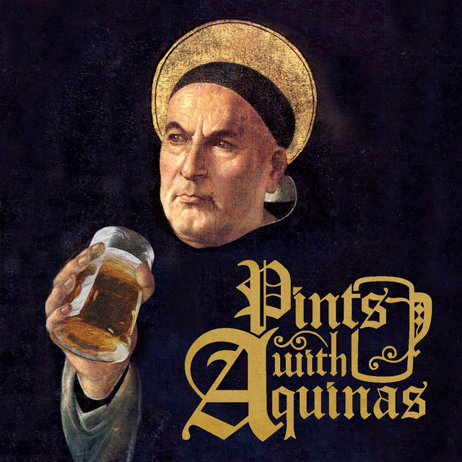
What is the “Summa”?
Most mature work of Aquinas
Manual to train preachers and confessors
Exitus-reditus
Synthesis of Greek, Jewish, and Muslim Philosophy, Theology, Patristics, and Scriptures
very empathetic towards his opponents (sic and non)
Precise and critical
Organic book
Parts – questions (treatises) – articles - arguments

Slide 55
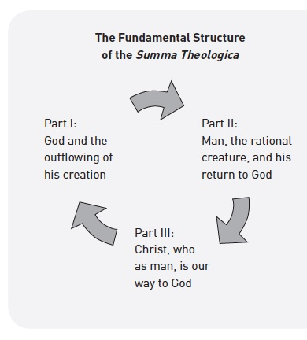
Structure of the Summa
3 Parts ("Pt."), subdivided into, 614 Questions (quaestiones; or "QQ"), subdivided into, 3,125 Articles ("Art.")
First Part (Prima Pars): The existence and nature of God; the creation of the world; angels; and the nature of man.
Second Part, subdivided into two sub-parts:
First part of the Second Part (Prima Secundae or Part I-II): General principles of morality (including a theory of law).
Second part of the Second Part (Secunda Secundae or Part II-II;): Morality in particular, including individual virtues and vices.
Third Part (Tertia Pars): The person and work of Christ, who is the way of man to God; and the sacraments. Aquinas left this part unfinished.

Slide 57
How to read the Summa?
Objections: "It seems that...." In this section Aquinas first states the position he will end up disagreeing with, and then gives what he thinks are the three best arguments against his own position.
Sed contra: "On the contrary...." This section states Aquinas' own position, and usually cites some authoritative text in support of his position.
"Response" This part presents Aquinas' argument in favor of his own position.
"Reply to.... " Here, Aquinas gives a reply to each of the arguments against his own position that he presented in the first part of the article. Often, the replies are counterarguments, but sometimes Aquinas simply tries to show that the apparent objections and his own position can be reconciled with one another, if both are properly understood.

