Slide 1
Economy, Divine and Human
Professor Kirk Doran
Lecture 5: Wednesday, September 6, 2023
Knowledge and increasing returns and growth

Slide 2
Outline
(1) Prayer
(2) Population: are there too many of us?
(3) Malthusian Effects
(4) What really happened: Technological Change
(5) Increasing returns and economic growth
(6) Knowledge and increasing returns
(7) A natural experiment
(8) Markets and public goods: who is left out?
(9) Interactions and Knowledge
(10) Closing Questions

Slide 3
Population Worries: Today
“As the population grows—and demand for water and land increases—it will be difficult to increase food production in a sustainable way. Furthermore, climate change will contribute to more erratic and extreme weather patterns, such as unprecedented droughts and floods that reduce available farm land, and will create more challenges for farming.”
A Practical Guide to Population and Development, (Population Reference Bureau, 2014)
Notes:
When thinking about material living standards, where are many fears today that overpopulation will cause hunger, climate change, and other problems. For example, this is a quotation from a few years ago in a report from the Population Reference Bureau, a prominent organization that promotes the worldwide spread of contraception and abortion.

Slide 4
Population Worries: 1968
“The battle to feed all of humanity is over. In the 1970’s hundreds of millions of people will starve to death in spite of any crash programs embarked upon now.”
The Population Bomb
(Paul Ehrlich, 1968)
Notes:
What may be somewhat surprising is that these worries, and even the level of alarmism and dire predictions, are not new. This is a quote from 1968 in a then famous, best-selling book called the Population Bomb, predicting mass starvation in the 1970s and 1980s because of exploding populations. The author Paul Ehrlich was not a crackpot but rather a chaired professor of biology at Stanford University. The book came out in 1968, two months after Pope Paul VI issued Humanae Vitae, an encyclical that insisted that the use of artificial contraception was unethical. The original version of the book predicted mass starvation in the 1970s. When these predictions did not come to pass, later versions would extend this to “the 1980s” as well.

Slide 5
Population Worries: 1923
US population by 1964 would reach 214 million—which would be “beyond the maximum agricultural possibilities”
Unless checked, world population would reach an unsupportable 3 billion by 2000
            Mankind at a Crossroads (Edward East, 1923)
Notes:
But we can go back another 45 years, and similar alarmist predictions of doom and gloom were made. Again, the author is not a random crackpot. Edward East was a professor of genetics at Harvard University and a proponent of “eugenics,” the idea of controlling the human gene pool by preventing some groups from reproducing, including things like forced abortion, contraception, and forced sterilization. Margaret Sanger, who started Planned Parenthood, was another eugenicist. After the fall of the Nazis, eugenics became less fashionable.
East’s predictions were false. By 2000, the U.S. population was already a well fed 328 million, far more than the 214 million that worried East. Moreover, the world was supporting a population of about 7 billion, more than twice what East thought was sustainable.

Slide 6
Population Worries: 1866
“Now population, when it grows, moves with a certain uniform impetus…it must outstrip all physical conditions and bounds; and the longer it continues, the more severely must the ultimate check be felt...I do not say that the failure of our coalmines will be the only possible check. Changes here, or in other parts of the world, may, even before the failure of our mines, reduce us to a stationary condition, and bring upon us at an earlier period the sufferings and dangers incident to our position. But such a grievous change, if it does not come before, must come when our mines have reached a certain depth.”
      “The Coal Question: An Inquiry Concerning the Progress of the Nation, and the
      Probable Exhaustion of our Coal Mines” (Stanley Jevons, 1866)
Notes:
Population concerns didn’t originally start from biologists, but from economists, however. Stanley Jevons, a well-known British professor of economics in the 19th century, argued that population would continue exploding leading to “sufferings and dangers”. Note there that the concern is that society would run out of natural resources, which is a commonly mentioned concern today. Together with natural gas, coal remains one of our top sources of electricity in the U.S., and of course many new technologies and types of energy have been introduced since 1866.

Slide 7

Thomas Robert Malthus
Economist, father of population economics
Anglican priest
Prophet of doom -- the “Dismal Science”
Key idea:
  Human Petri dish
  In equilibrium
  $$Subsistence Requirement=\frac{Total Food Output}{Population}$$
Perhaps the first, and most well known, of many erroneous predictions by economists!
Notes:
Where does all this alarmism about population start? It dates back principally to Thomas Robert Malthus, who is pictured in the upper right corner. Malthus was an English economist and Anglican priest who wrote the first version of his famous work “An Essay on the Principles of Population” in 1798, and continued updating it for decades well into the mid-19th century. This work made him famous even in his time, and he is best remembered for being a prophet of doom, as well as for being the person chiefly responsible for economics being described as “the Dismal Science”.

Slide 8
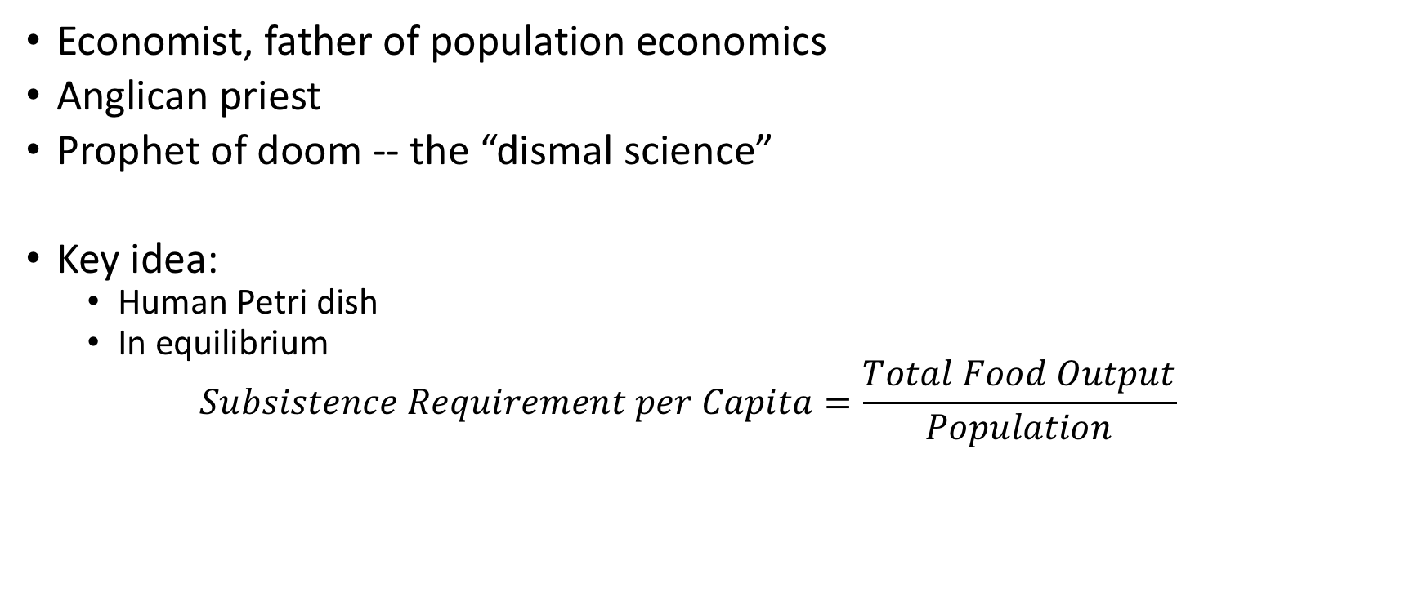
Thomas Robert Malthus
Economist, father of population economics
Anglican priest
Prophet of doom -- the “dismal science”
Key idea:
  Human Petri dish
  In equilibrium
  $$Subsistence Requirement per Capita=\frac{Total Food Output}{Population}$$
Perhaps the first, and most well known, of many erroneous predictions by economists!
Notes:
Malthus viewed human beings on earth, the same way biologists might view bacteria in a Petri dish. There is a certain amount of food that every person needs to survive, called the “subsistence requirement”. He believed that population would always grow until the level of food “per capita” equaled this subsistence amount. When we talk about something ”per capita”, we mean per person, and it is calculated by dividing the total amount of that something by the population.

Slide 9
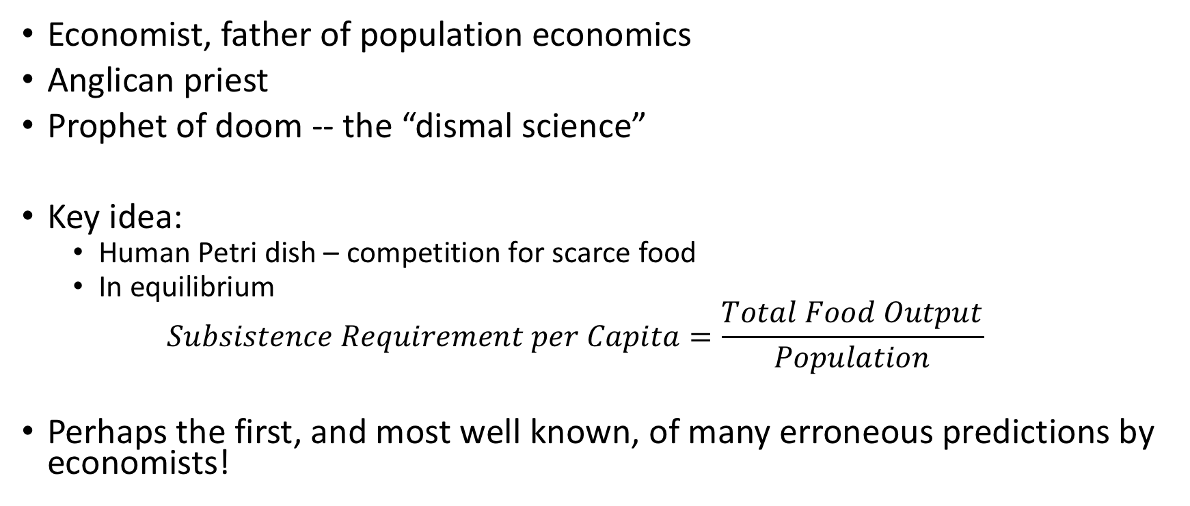
Thomas Robert Malthus
Economist, father of population economics
Anglican priest
Prophet of doom -- the “dismal science”
Key idea:
  Human Petri dish – competition for scarce food
  In equilibrium
  $$Subsistence Requirement per Capita=\frac{Total Food Output}{Population}$$
Perhaps the first, and most well known, of many erroneous predictions by economists!
Notes:
Economists are notorious for making predictions that turn out to be wrong, and this is perhaps the most famous bad prediction of an economist. Nearly 200 years later, Robert Lucas, a Nobel Prize winning economist, would describe Malthus’ reasoning as “famous nonsense”, but the ideas of Malthus are still popular among economists and non-economists today.

Slide 10
Why? Malthus’ “Famous Nonsense”
Food,
Population
Food supply grows “arithmetically”
Time
Notes:
So what was Malthus’ theory? Here we have plotted a graph showing the increase of the food supply over time. Malthus argued that the food supply increased “arithmetically” over time. That is, the available supply of food would increase by the same absolute amount each year. Today, in mathematics we would call this a linear relationship. (Note that if the food supply is increasing, then if we increase the same absolute amount each year, it will be a smaller percentage increase each year. An increase of 1,000 tons of wheat is a larger percentage increase when the existing food supply is 2,000 tons of wheat than when the existing food supply is 2,000,000 tons of wheat.)
This assumption is the first part of Malthus’ theory and is the faultiest part of Malthus prediction.

Slide 11
Why? Malthus’ “Famous Nonsense”
Food,
Population
Food supply grows “arithmetically”
“Unchecked” populations grows “geometrically”
Time
Notes:
The second part of his theory is that “unchecked” – that is, absent anything constraining its growth -- human population would grow “geometrically”. By “geometrically”, he meant that each year, the population would increase by a constant percentage. (A constant percentage increase requires an ever increasing absolute increase in population. An increase of 1% more people is only 1,000 extra people if the population is currently 100,000, but a 1% increase is an extra million people, if the current population is 100 million.) In mathematics today, we would call this an exponential relationship. It arises, from the natural mathematics of reproduction: if you have 2 rabbits on your rabbit farm, and each rabbit couple has four children, then the 2nd generation will be 4 rabbits, the 3rd generation will be 8 rabbits, the 4th generation will be 16 rabbits, etc. The total increase in children is increasing in the original number of parents (although the percentage rate of increase remains constant).
Because Malthus assumed that population would increase faster than food, the amount of available food per person would fall over time causing a problem.

Slide 12
Checks on Population
Food,
Population
Food per Person
Large population declines to subsistence
Declining Food Per Person
Subsistence Food Requirement
Small population grows to subsistence
Rising Food Per Person
Time
Time
Notes:
What if the population was large to begin with (as in the purple lines)? Then the amount of food per person would be below what is necessary to survive. “Checks”, e.g., more deaths and fewer births, would cause the population to fall until the bulk of the population had this subsistence level of food. These checks were something of great concern to Malthus. He listed them as “misery, vice, and moral restraint”. By “misery”, he meant that if there were not enough food to feed everyone, some people would die from starvation, malnutrition, and the poor health and disease that these led to. By “vice”, he said that people would go to war against other countries to try to acquire food. They would also fight and kill amongst themselves, including abortion and infanticide. In extremes, people would even resort to cannibalism. All of these have happened historically.

Slide 13
What really happened since Malthus?
Food,
Population
Food per Person
Growth in Food per Person Well Beyond Subsistence
Exponential
Growth in Food, Output
Exponential
Growth in Population
Subsistence Food
Time
Time
Notes:
This lecture will cover what has really happened in the world since Malthus wrote. In short, Malthus’ prediction was wrong. We will present actual facts and figures, but a simple picture of happened is presented above. Notice that population has grown exponentially, or “geometrically” as Malthus phrased it (green line in the left graph). However, in contrast to Malthus’ predictions, the food supply has also grown exponentially (red line in the left graph). Consequently, food per person (the green dashed line in the right graph) has grown over time far beyond subsistence. In fact, in most advanced societies, obesity is a much larger health problem than malnutrition!

Slide 14
8-Fold Increase in World Population
(Relative to 1800)
Sources: DeLong (1998) and United Nations (World at Six Billion, 2016)
Notes:
That is all stylized, but let’s look at the actual data. Well, in many ways it has increased “geometrically” just as Malthus said it would when food was available. Here is a graph of the world population over time. To make it easier to read, we have plotted the world population relative to the population in 1800, about the time when Malthus wrote. Between 1800 and 2014, the population increased over 8 fold. In absolute terms, it amounts to an increase from 900 million people in 1800 to 7.3 billion people today.
Obviously, this hasn’t led to the poverty that Malthus and others have envisioned. Why not?

Slide 15
120-Fold Increase in World Income
(Relative to 1800)
Sources: DeLong (1998) and CIA (World Factbook, 2016)
Notes:
Well, we can look at total world income. Here we have again plotted the world’s income relative to the world’s income in 1800. This income is in “real” terms, meaning we have already adjusted for things like inflation and differences in currencies and prices across countries.
The graph shows that income didn’t increase “arithmetically” in a straight line, like Malthus thought the food supply would. Instead it increased “geometrically” (or exponentially, as we would now say) in the same way that population did. If we pay attention to the income axis, however, we can see that it increased at a much faster rate. While the world’s population increased 8 fold, world income increased about 120 fold!

Slide 16
15-Fold Increase in Average Income
(Relative to 1800)
Note: Calculated from sources above.
Notes:
What did this mean for average incomes in the world? This line shows what happened to income per capita, and this also increased geometrically and again at a much faster rate than population growth. Total income increased roughly 120 fold, and population increased roughly 8 fold. Simple division (120/8=15) shows that income per capita increased roughly 15 fold. In absolute terms, measured in today’s dollars, this amounts to an increase from about $1,300 annual income in 1800 to just under $20,000 annual income in 2014.
Of course, growth has not been even in all countries or within any country. Average incomes tend to be driven up by the few super rich people in the world, so that most people today live on much less than $20,000. In fact, there are still a large number of people living on less than $2/day, and so global poverty is an important concern. However, even the fraction of people in the world who are ultra poor like these has fallen dramatically. In 1800, most of the people in almost every country lived at this level of poverty. Today, the World Bank estimates that less than ten percent of the world’s population live on this. That is still a large number – over 700 million people living in poverty – but even the absolute number of ultra poor has fallen over the past 25 years.

Slide 17
Why? New Technologies from the Industrial Revolution…
Notes:
Later advances occurred in consumer goods, petroleum, chemicals, life-saving medicines, and electronics.

Slide 18
… and the agricultural revolution.
Notes:
But the industrial revolution was also spurred by an agricultural revolutions with technologies like tractors, fertilizer, and advanced high yield seeds. Together, these have allowed us to greatly increase the supply of food, while doing so with fewer and fewer workers.

Slide 19
… dirty and clean technologies.
Notes:
. . . The industrial revolutions has also led to a mix of new technologies, some of them highly polluting, while others – especially more recent – that have been cleaner. What does population have to do with the discovery and implementation of all these technologies? That is what Professor Doran will speak explain.

Slide 20
 | Chad | US in 1850 | US
GDP/person | $1,600 | $2,700 | $46,300
Infant mort. | 9.7% | 23% | 0.8%
Life exp. | 48 years | 40 years | 78 years
% farming | 80% | 58% | 3%
Prim. Sch. | 40% | 63% | 98%
20
Notes:
[THIS SLIDE HAS THREE PARTS; PRESS THE NEXT BUTTON TO PROCEDE FROM PART TO PART]
A major theme of today’s lecture can be summarized in this chart.
[PRESS THE NEXT BUTTON. READ the figures in the Table for Chad].
You can see some key economic variables for the country of Chad, measured recently.
Clearly Chad produces very little per person.
But it also has high infant mortality, a very low life expectancy, many people in farming (an occupation with many health hazards and little opportunity for advancement) and relatively few people with primary schooling completed.
[PRESS THE NEXT BUTTON. READ the figures in the Table for the next country].
The next, unnamed country experiences similar circumstances to Chad.
It is doing better in some respects, but worse in others.
Finally, consider the circumstances in the United States.
[PRESS THE NEXT BUTTON. READ the figures in the Table for the USA].
People in the US produce much more per person.
Infant mortality is massively lower, life expectancy much higher.
Opportunities for advancement, learning, and travel are all much higher.
The question is: which country is the unnamed country in the middle column?
[ALLOW THE CLASS TO GUESS].
[PRESS THE NEXT BUTTON].
The answer is: the United States in 1850.
20

Slide 21
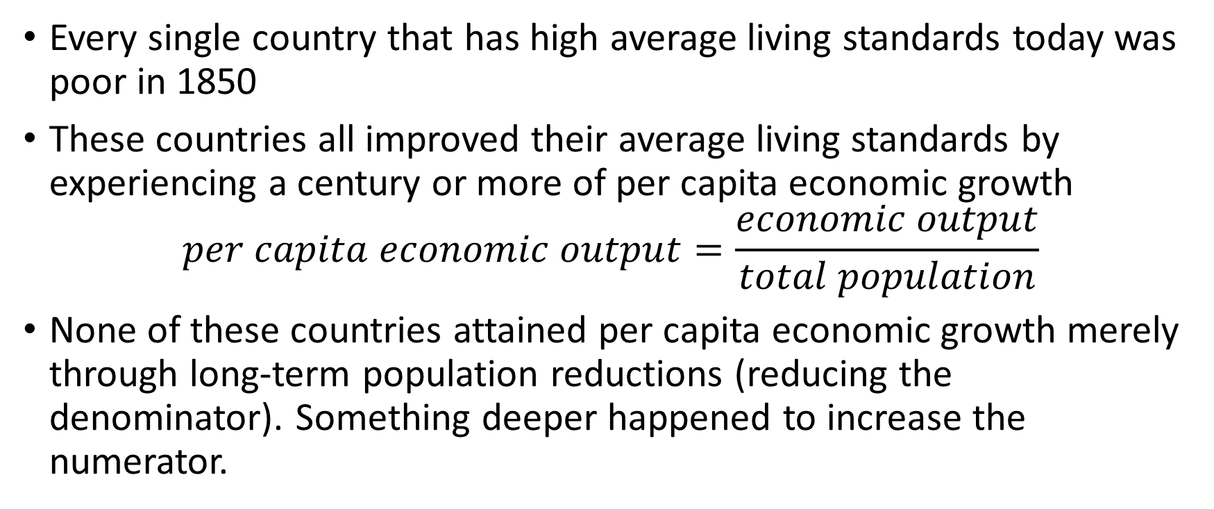
The importance of growth
Every single country that has high average living standards today was poor in 1850
These countries all improved their average living standards by experiencing a century or more of per capita economic growth
$$per capita economic output=\frac{economic output}{total population}$$
None of these countries attained per capita economic growth merely through long-term population reductions (reducing the denominator). Something deeper happened to increase the numerator.
Notes:
Every single country that has high average living standards today was poor in 1850.
These countries all improved their average living standards by experiencing a century or more of per capita economic growth.
Per capita economic growth is growth in the fraction defined by economic output (the numerator) divided the number of people (the denominator).
And here is the key: none of these countries which were poor but became rich attained per capita economic growth merely through long-term population reductions (reducing the denominator). In every case, something deeper happened to increase the numerator. Without increases in the numerator (economic output), countries never become rich enough to support a physically healthy, well-educated, and flourishing population.

Slide 22
What makes economies grow?
Economic growth = growth in economic output per person
What makes economies grow? Is it more physical capital (factories)?
Notes:
So the question is? What is it that makes economies grow?

Slide 23
Capital and growth
Notes:
One obvious answer: the U.S. has better physical stuff to use to produce things.
The U.S. has better factories, better equipment within factories, better computers, better roads, etc.
We call the physical stuff that we use to produce things “Capital”.

Slide 24

Capital and growth
Notes:
Suppose that we started with one worker, shown here, working in one factory.

Slide 25
Capital and growth
Notes:
We can see that that one worker working in one factory produces one unit of output.

Slide 26
Capital and growth
Notes:
What happens when we add more physical capital (another factory)?
Are we going to get more output per person?
If so, how much more output will we get?

Slide 27
Capital and growth
Notes:
Well, the one worker will now split up his or her time between the two factories.

Slide 28
Capital and growth
Notes:
We might hope that worker to be able to produce twice as much output as before, because he or she has twice as much physical capital as before to work with.

Slide 29
Capital and growth
Notes:
But this is unlikely.
Remember that the worker’s time is limited, and now he or she has to split up his time between two factories.

Slide 30
Capital and growth
Notes:
So in reality, when we double the amount of physical capital, we less than double the amount of output.

Slide 31
Capital and growth
Notes:
Well maybe the problem can be solved by just adding even more physical capital.

Slide 32
Capital and growth
Notes:
Now the worker will work in all three of these factories.

Slide 33
Capital and growth
Notes:
Will we get three units of output now?

Slide 34
Capital and growth
Notes:
No, of course not!
The worker now has to split up his or her time between three different factories, giving him or her less time to produce in each of them.

Slide 35
Capital and growth
Notes:
So now we will produce even less per factory than we did last time.
We tripled the amount of physical capital, but we much less than tripled the amount of total output.

Slide 36
Capital and growth
When labor is fixed, each extra unit of capital produces a smaller increase in output
This is called diminishing marginal returns, and it is one of the most empirically-verified phenomena in all of economics
We also call it decreasing returns to scale: as the scale of our factories doubles, our output less than doubles
Notes:
What is happening here?
When the amount of labor is fixed, each extra unit of capital produces a smaller increase in output.
This is called diminishing marginal returns, and it is one of the most empirically-verified phenomena in all of economics.
We also call it decreasing returns to scale: as the scale of our factories doubles, our output less than doubles.

Slide 37
Capital and Labor together
Notes:
Here is our worker and his factory.

Slide 38
Capital and Labor together
Notes:
Together, he and his factory can produce one unit of output.

Slide 39
Capital and Labor together
Notes:
Here is another factory.

Slide 40
Capital and Labor together
Notes:
And here is the second worker, working in her factory.

Slide 41
Capital and Labor together
Notes:
She can also produce one unit of output in her factory.

Slide 42
Capital and Labor together
Notes:
There’s no longer any congestion on either the labor or the capital side, so now when we double the amount of inputs, we also double the amount of outputs.
Twice as much labor and capital combined means twice as much output as before.

Slide 43

Capital and Labor together
Notes:
But is this really per capita economic growth? We doubled output, but we also doubled the number of mouths to feed.

Slide 44
Capital and Labor together
If we increase both capital and labor, then the best we can do is constant returns to scale
We double our inputs, and we get double our output
Notes:
If we increase both capital and labor, then the best we can do is constant returns to scale.
We double our inputs, and we get double our output.

Slide 45
Constant returns to scale and growth
In a world of constant returns to scale, we can’t have per capita economic growth
The best we can do in that world is to match any increases in population by a proportionate increase in production: per capita is constant
Maybe we need increasing returns to scale to get per capita economic growth
Notes:
In a world of constant returns to scale, we can’t have per capita economic growth.
The best we can do in that world is to match any increases in population by a proportionate increase in production: per capita is constant.
Maybe we need increasing returns to scale to get per capita economic growth.

Slide 46
Increasing Returns to Scale
Under increasing returns to scale, if we double all of our inputs, we more than double our outputs.
That means that each worker gets more then they used to
That means long-term economic growth!
Notes:
Under increasing returns to scale, if we double all of our inputs, we more than double our outputs.
That means that each worker gets more then they used to.
That means long-term economic growth!

Slide 47
Knowledge
Maybe there’s another input to production we’ve forgotten, that gives increasing returns
We’ve covered the physical stuff that goes into production (raw materials, factories, etc).
We’ve covered the labor that manipulates that physical stuff
What about the instructions for manipulating that stuff? What about knowledge?
Notes:
Maybe there’s another input to production we’ve forgotten, that gives increasing returns.
We’ve covered the physical stuff that goes into production (raw materials, factories, etc).
We’ve covered the labor that manipulates that physical stuff.
What about the instructions for manipulating that stuff? What about knowledge?

Slide 48
Knowledge and growth
Notes:
Here is our factory again.

Slide 49
Knowledge and growth
Notes:
Here is our worker in the factory.

Slide 50
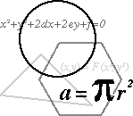
Knowledge and growth
Notes:
And here is the knowledge that worker is using.

Slide 51
Knowledge and growth
Notes:
This worker using this knowledge in this factory produces this unit of output.

Slide 52
Knowledge and growth
Notes:
Now let’s try doubling all the inputs and we’ll see what happens.
First we double the factories.

Slide 53
Knowledge and growth
Notes:
Then we double the workers.

Slide 54
Knowledge and growth
Notes:
Then we double the knowledge.

Slide 55
Knowledge and growth
Notes:
But wait.
Doubling the knowledge doesn’t mean writing the same equations down twice.

Slide 56
Knowledge and growth
Notes:
Once an equation is known to be true, you don’t need to re-prove it, or re-write it down so that multiple people can use it.

Slide 57
Knowledge and growth
Notes:
Of course, multiple people can use the formula for the area of a circle, A = Pi times R squared, without there being less of that formula left for anyone else to use.

Slide 58
Knowledge and growth
Notes:
So that means that once we know one piece of knowledge is true, we don’t need to double it by writing it down twice.
Rather, we double the stock of knowledge by discovering some new piece of knowledge, such as E = M C squared.

Slide 59
Knowledge and growth
Notes:
And here is the crucial point.
Each of these pieces of knowledge can be used without diminishment by both workers.
That means that when we double all the inputs, each worker gets access to one undiminished factory, and two pieces of undiminished knowledge.

Slide 60
Knowledge and growth
Notes:
Since each worker now has more stuff to work with, it is plausible that each worker produces more than he or she produced before.
We doubled the inputs, and we more than doubled the outputs.
This is increasing returns to scale.
This is long-term per capita economic growth.

Slide 61
Knowledge is non-rival
Thomas Jefferson on Knowledge:
  “It’s peculiar character. . . is that no one possesses the less, because every other possesses the whole of it. He who receives an idea from me, receives instruction himself without lessening mine; as he who lights his taper at mine receives light without darkening me.”
Notes:
So where did the increasing returns to scale come from?
They came from the fact that knowledge can be shared by more than one person without diminishing.
Economists call that property “non-rival”.
Knowledge is non-rival because when more than one person uses it, there is not less of it for anyone else to use.
As Thomas Jefferson noted two centuries ago:
“It’s peculiar character. . . is that no one possesses the less, because every other possesses the whole of it. He who receives an idea from me, receives instruction himself without lessening mine; as he who lights his taper at mine receives light without darkening me.”

Slide 62
How do we produce more knowledge?
If more knowledge means faster growth, then the question remains: how do we produce more knowledge?
Notes:
If more knowledge means faster growth, then the question remains: how do we produce more knowledge?

Slide 63
How do we produce more knowledge?
Maybe important knowledge comes when a genius has a “Eureka!” moment.
In that case, we can produce more knowledge by making sure there are more geniuses.
How do we get more geniuses?
Notes:
Maybe important knowledge comes when a genius has a “Eureka!” moment.
In that case, we can produce more knowledge by making sure there are more geniuses.
How do we get more geniuses?

Slide 64
Knowledge and Population
William Petty, 1682:
  “As for the Arts of Delight and Ornament, they are best promoted by the greatest number of emulators. And it is more likely that one ingenious curious man may rather be found among 4 million than 400 persons.”
Notes:
Economists and people in general have been thinking about that question for a long time. Here is William Petty, writing in 1682:
“As for the Arts of Delight and Ornament, they are best promoted by the greatest number of emulators. And it is more likely that one ingenious curious man may rather be found among 4 million than 400 persons.”

Slide 65
Knowledge and Population
E.S. Phelps, 1968:
  “One can hardly imagine, I think, how poor we would be today were it not for the rapid population growth of the past to which we owe the enormous number of technological advances enjoyed today. . . If I could re-do the history of the world, halving population size each year from the beginning of time on some random basis, I would not do it for fear of losing Mozart in the process.”
Notes:
Nobel Laureate Edmund Phelps wrote in 1968:
“One can hardly imagine, I think, how poor we would be today were it not for the rapid population growth of the past to which we owe the enormous number of technological advances enjoyed today. . . If I could re-do the history of the world, halving population size each year from the beginning of time on some random basis, I would not do it for fear of losing Mozart in the process.”

Slide 66
A Natural Experiment
We need a natural experiment:
Several areas start with the same technology
But they have different initial populations
We let them develop over the long-term
Then, after a few thousand years, we drop in and see whether the places that started with higher populations now have better technology, or worse technology
Notes:
So it seems that to obtain long-term per capita economic growth – the only thing that has ever lifted entire countries out of poverty – it is necessary to accumulate knowledge.
And it is plausible that the larger the population at any point in time, the more knowledge that population can produce, ceteris paribus (all else being equal).
How can we test whether this is the case?
How can we use empirical evidence (real world data) to determine whether a larger population, all else equal, will produce more knowledge over the long term than will a smaller population?
Ideally, we would have an experiment.
We could take many different regions, reduce them all to the same state of knowledge, and let some regions have larger initial populations than others.
Finally, we would cut the regions off from all contact with each other for a period of thousands of years (long enough for a slow-moving process like the accumulation of knowledge to have obvious effects) and then see which region had produced the most knowledge by the end of the experiment.
I applied to the National Science Foundation for funding for this experiment, but, strangely, they said they didn’t have the funds for it.
When economists can’t run an actual experiment to test something, they use what is called a natural experiment.
Let’s consider a natural experiment studied by Michael Kremer, a Harvard economist and MacArther “Genius grant” winner.

Slide 67
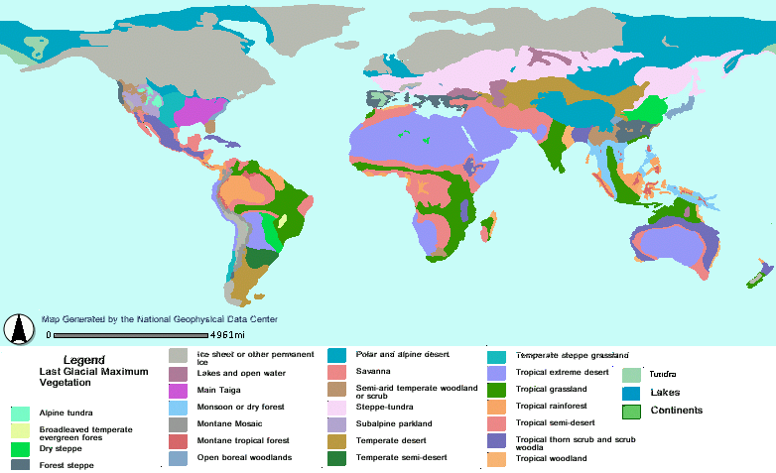
110,000BC – 8000BC: last ice age!
Notes:
Between 110,000 BC and 8,000BC the earth was in one of its periodic “Ice Ages”.

Slide 68
110,000BC – 8000BC: ice bridges and land bridges
Notes:
As a result of the ice levels, there were lower sea levels. This allowed for both ice and land bridges to connect areas that are separated by water today.

Slide 69
110,000BC – 8000BC:
4 Connected Regions
Notes:
As a result, the four regions shown above were all connected in a way that allowed early humans to travel between them.

Slide 70
110,000BC – 8000BC:
4 Connected Regions
Population density everywhere: 0.03 people per square kilometer
Notes:
The population density everywhere at that time was around 0.03 people per square kilometer.

Slide 71
110,000BC – 8000BC:
4 Connected Regions
VERY BIG POPULATION
BIG POPULATION
Medium population
Small population
Population density everywhere: 0.03 people per square kilometer
Notes:
As a result, the region with the largest land area (the “old world” of Africa, Asia, and Europe combined) also had the largest population.
The region with the second largest land area had the second largest population, etc.

Slide 72
110,000BC – 8000BC:
4 Connected Regions
VERY BIG POPULATION
BIG POPULATION
Medium population
Small population
Population density everywhere: 0.03 people per square kilometer
Technology everywhere: stone-age technology
Notes:
The technology everywhere was a similar stone-age technology.

Slide 73

8000BC: ice bridges melt, sea levels rise, land bridges drown:
4 Separated Regions
VERY BIG POPULATION
BIG POPULATION
Medium population
Small population
Notes:
Around 8,000BC, the ice age ends.
The Ice bridges melt, the sea levels rise, and the land bridges drown.
As a result, the 4 connected regions become 4 separated regions.

Slide 74
In 8,000BC, the experiment begins. . .
VERY BIG POPULATION
BIG POPULATION
Medium population
Small population
Notes:
The natural experiment thus begins. . .

Slide 75
For 9,500 years, each region develops technology on its own
VERY BIG POPULATION
BIG POPULATION
Medium population
Small population
Notes:
For 9,500 years, each region develops technology on its own.

Slide 76
Until. . .1500AD:
4 Connected Regions Again!
Notes:
Until circa 1500AD, when the 4 connected regions come into contact with each other again.

Slide 77
1500AD: natural experiment ends. . who has the best technology?
Notes:
Once the natural experiment ended, we can ask: which region developed the best technology over the course of the 9,500 year natural experiment?
All the regions started with similar stone age technology, but they started with different initial populations.

Slide 78
1500AD: natural experiment ends. . who has the best technology?
Early modern technology
Notes:
The region with the largest initial population had the best technology by the end of the experiment.
They had large cities, advanced calendars and mathematics, intricate agriculture, and early modern technology and machinery, including the technology used to travel to the other three regions.

Slide 79
1500AD: natural experiment ends. . who has the best technology?
Early modern technology
Agriculture, cities, elaborate calendars
Notes:
The region with the second-largest initial population had the second-most advanced technology by the end of the experiment.
They had large cities, advanced calendars and mathematics, intricate agriculture, but no modern technology or machinery such as the wheel, etc.

Slide 80
1500AD: natural experiment ends. . who has the best technology?
Early modern technology
Agriculture, cities, elaborate calendars
Hunter gatherers with good stone tools
Notes:
The region with the third largest starting population had the third most advanced technology by the end of the experiment.
They had no elaborate cities or mathematics, but they did have better tools than they started with.

Slide 81
1500AD: natural experiment ends. . who has the best technology?
Early modern technology
Agriculture, cities, elaborate calendars
Hunter gatherers with good stone tools
Bad stone tools
Notes:
The region with the fourth largest starting population had the fourth most advanced technology by the end of the experiment.
They had limited stone tools.

Slide 82
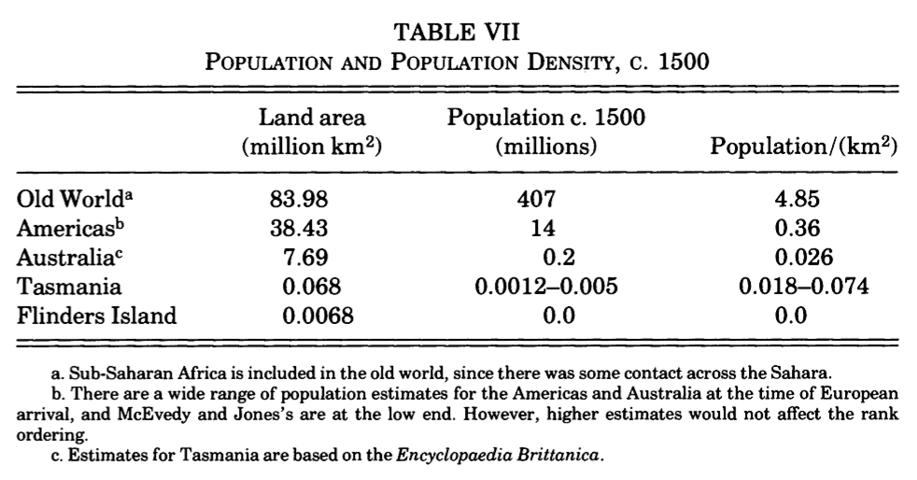
The natural experiment: results

Slide 83
The natural experiment: results

Slide 84
The natural experiment: results

Slide 85
The natural experiment: results

Slide 86
Knowledge growth and Population
This is just one simple empirical exercise. There is a lot of research on this topic.
My take on the literature: Ceteris paribus, maintaining a large population increases the probability of big discoveries of useful knowledge in the long run.
Replacement rate fertility to keep world population steady:
  2.1 births per woman
US fertility: 1.64 births per woman and falling
EU fertility: 1.55 births per woman and falling
China fertility: 1.3 births per woman

Slide 87
Competition and Interaction
More generally, economics is about two forces:
  Rivalrous Competition
  Fruitful Interaction
We’re used to thinking about the competition part: that’s what makes us tend to believe that more people means less for each person.
Notes:
Why could large populations be useful for the long-term economic wellbeing of people?
It seems intuitive that the result should be the opposite: the more people we have to compete with for scarce resources, the worse off we will be.
But more generally, economics is about two forces, which we will call:
Rivalrous Competition
Fruitful Interaction
We’re used to thinking about the competition part: that’s what makes us sure that more people means less for each person.

Slide 88
Competition and Interaction
But more people also means more potential interactions
Interactions can create value:
  Generate knowledge
  Exchange goods and services
Notes:
But more people also means more potential interactions.
Interactions can create value, through generating knowledge, as well as the mutually-beneficial exchange of goods and services.

Slide 89
Competition and Interaction
And here’s the crucial point: as the number of people increases, the number of potential interactions between people increases faster than the number of people
2 people: 1 interaction
3 people: 3 interactions
4 people: 6 interactions
5 people: 10 interactions
Notes:
And here’s the crucial point: as the number of people increases, the number of potential interactions between people increases faster than the number of people
2 people: 1 interaction
3 people: 3 interactions
4 people: 6 interactions
5 people: 10 interactions

Slide 90
Competition and Interaction
Population: n
Potential interactions: n(n-1)/2
Increase in potential interactions that we get from population n increasing to population n+1 is larger than the decrease in the share of the pie from population n increasing to n+1
Notes:
With a population of n people, the number of potential interactions is n(n-1)/2.
The increase in the number of potential interactions that we get from a population of n increasing to a population of n+1 is larger than the decrease in the share of the pie that happens from a population of n increasing to n+1.
The number of potential interactions grows faster than the size of each pie slice declines.

Slide 91
So, what can we do?
Don’ts: invest only in physical capital
let populations shrink indefinitely
Do’s: invest in education
invest in institutions
( -- physical security, -- basic property rights, -- intellectual property rights, -- laboratories, -- research centers )

Slide 92
So, what can we do?
Don’ts: invest only in physical capital
let populations shrink indefinitely
Do’s: invest in education
invest in institutions
( -- physical security, -- basic property rights, -- intellectual property rights, -- laboratories, -- research centers )
Give people tools and incentives to develop and share all the useful knowledge (scientific and general) that will induce long-term growth

