Slide 1
“Chaos was the law of nature; Order was the dream of man.”
-- Henry Adams, The Education of Henry Adams (an Autobiography)

Slide 2
Economy, Divine and Human
Professor Kirk Doran
Lecture 2: Monday, August 28, 2023
Demand, Supply, and Market Equilibrium

Slide 3
Outline
(1) Prayer
(2) Market Experiment
(3) Two assumptions ➔ Existence of Demand Curves, Law of Demand
(4) Two assumptions ➔ Existence of Supply Curves, Law of Supply
(5) Market Equilibration: Why and How?
(6) Evidence for these phenomena
(7) In-class Problem: Supply and Demand changes
(8) Common Objections to generalizability
(9) Who is left out?
(10) Questions

Slide 4
Market Experiment
Let’s open up our laptops, log into Cengage, and get started with an Experiment!!!

Slide 5
Market Experiment Prediction
Predicted Price = approximately $1.08
Predicted Quantity = approximately 12

Slide 6
Why was this pattern precise & predictable?
We could have had chaotic prices with no discernable order
We could have had a precise order in prices that was unpredictable
Instead, we got a precise order in prices that we understand well enough that we can predict
How did this happen?
To what extent did humans “dream” of this order and create it?
If humans did not do so, who did?

Slide 7
What is the most you would pay for. . .?
My pocket square

Slide 8
Two things we noticed
If you’re willing to pay a high price, you’re still willing to pay a lower price
There is a diversity in the maximum price you’d be willing to pay

Slide 9
Two assumptions ➔ Demand Curves
Let me show on the board how these two assumptions lead to the existence of Demand curves, and to something called the Law of Demand

Slide 10
Two assumptions ➔ Supply Curves
Let me show on the board how two similar assumptions lead to the existence of supply curves and something we will call the Law of supply

Slide 11
Market Equilibrium: why and how?
Today, I’ll show on the board a classical explanation of the Law of Supply and Demand.
In Lecture 6, I’ll share a more realistic explanation that will help close out our econ section and transition to studying History and Theology.

Slide 12
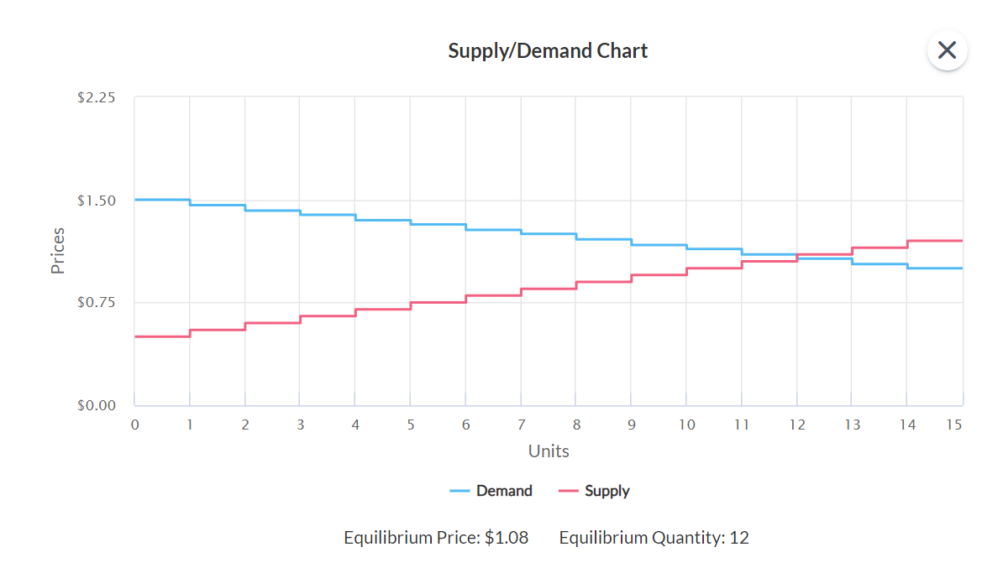
Market Experiment: Supply and Demand

Slide 13
Evidence for these phenomena
We have thousands of pieces of evidence for these phenomena from outside the laboratory, from something called natural experiments.
For quasi-random reasons, demand increases or decreases; supply increases or decreases.
Things happen to prices and quantities that reveal that the Law of Demand, the law of Supply, and Law of Supply and Demand must be true.

Slide 14
In-class problems: supply & demand changes
To see why, let’s do some in-class problems about supply and demand changes.
I will write them on the board, and you will work in groups of 2-4

Slide 15
Common Objections to Generalizability
People (often theologians!) who are irritated or alarmed by the existence of these patterns have several common objections:

Slide 16
Common Objections to Generalizability
People (often theologians!) who are irritated or alarmed by the existence of these patterns have several common objections:
  They only exist in laboratories

Slide 17
Common Objections to Generalizability
People (often theologians!) who are irritated or alarmed by the existence of these patterns have several common objections:
  They only exist in laboratories
  They only exist in societies in which people have been taught to commoditize themselves, and instrumentalize their relationships with each other (often because they’ve been taught by economists themselves!)

Slide 18
Common Objections to Generalizability
People (often theologians!) who are irritated or alarmed by the existence of these patterns have several common objections:
  They only exist in laboratories
  They only exist in societies in which people have been taught to commoditize themselves, and instrumentalize their relationships with each other (often because they’ve been taught by economists themselves!)
  There is some way in which the leaven of the Gospel would transform these patterns.

Slide 19
What have we learned from this?
What have we learned from the existence of this equilibrium?

Slide 20
What have we learned from this?
What have we learned from the existence of this equilibrium?
Are there hints of how we can connect this to philosophy and theology as the course progresses?

Slide 21
“Chaos was the law of nature; Order was the dream of man.”
-- Henry Adams, The Education of Henry Adams (an Autobiography)

Slide 22
What were we thinking about during exchange?
Were we thinking about creating one price that all transactions would converge to?

Slide 23
What were we thinking about during exchange?
Were we thinking about creating one price that all transactions would converge to?
Were we thinking about society more broadly during the act of each exchange, or what we will later call social justice?

Slide 24
What were we thinking about during exchange?
Were we thinking about creating one price that all transactions would converge to?
Were we thinking about society more broadly during the act of each exchange, or what we will later call social justice?
During each exchange, we thought about commutative justice:

Slide 25
What were we thinking about during exchange?
Were we thinking about creating one price that all transactions would converge to?
Were we thinking about society more broadly during the act of each exchange, or what we will later call social justice?
During each exchange, we thought about commutative justice:
COMMUTATIVE JUSTICE.
  That virtue whose object is, to render to every one what belongs to him, as nearly as may be, or that which governs contracts.
  The word commutative is derived from commutare, which signifies to exchange.

Slide 26
What did commutative justice give us?
How much have we gotten from this commutative justice?

Slide 27
What did commutative justice give us?
How much have we gotten from this commutative justice?
Was every individual happy?

Slide 28
What did commutative justice give us?
How much have we gotten from this commutative justice?
Was every individual happy?
Possibly not; after all, not everyone transacted!!!

Slide 29
Who is left out?
Let’s draw a picture on the board and see if we can determine who has been left out of this equilibrium pattern.

Slide 30
Who is left out?
Let’s draw a picture on the board and see if we can determine who has been left out of this equilibrium pattern.
The people who are left out are those who would never be able to find a mutually beneficial exchange with each other at any price.

Slide 31
Who is left out?
Let’s draw a picture on the board and see if we can determine who has been left out of this equilibrium pattern.
The people who are left out are those who would never be able to find a mutually beneficial exchange with each other at any price.
Is there some normative principle or order that this hints at?

Slide 32
Hints of a deeper order
Finally, we get hints of an even deeper order:

Slide 33
Hints of a deeper order
Finally, we get hints of an even deeper order:
All transactions tend to occur at one price, rather than many different prices.

Slide 34
Hints of a deeper order
Finally, we get hints of an even deeper order:
All transactions tend to occur at one price, rather than many different prices.
We get the one price that maximizes the number of interactions that could ever occur at one price.

Slide 35
Hints of a deeper order
Finally, we get hints of an even deeper order:
All transactions tend to occur at one price, rather than many different prices.
We get the one price that maximizes the number of interactions that could ever occur at one price.
This suggests some questions we should ask each other.

Slide 36
Questions
Does this have to do with the deeper things of life, such as our labor and our ability to support ourselves and our families?

Slide 37
Questions
Does this have to do with the deeper things of life, such as our labor and our ability to support ourselves and our families?
Is it possible for us share commutatively just exchanges with large numbers of people who are strangers to us?

Slide 38
Questions
Does this have to do with the deeper things of life, such as our labor and our ability to support ourselves and our families?
Is it possible for us share commutatively just exchanges with large numbers of people who are strangers to us?
Is it possible to instantiate deeper forms of justice and love than commutative justice for large numbers of people who are strangers to us?

Slide 39
Questions
Does this have to do with the deeper things of life, such as our labor and our ability to support ourselves and our families?
Is it possible for us share commutatively just exchanges with large numbers of people who are strangers to us?
Is it possible to instantiate deeper forms of justice and love than commutative justice for large numbers of people who are strangers to us?
Are there any reasons why we might owe the most justice we can bring about (whatever level of justice that is) with as many people as possible?

