Slide 1
“Socialism has been in existence long enough for behavioral regularities to have developed and become set”
– Janos Kornai, The Socialist System

Slide 2
Economy, Divine and Human
Professor Kirk Doran
Lecture 10: Monday, September 25, 2023
Against the Church and the market: Classical Socialism

Slide 3
Outline
(1) Prayer
(2) Review
(3) Marx’s Image of Socialism
(4) Where do we get the Evidence?
(5) Undivided power of the Marxist-Leninist party; Dominant influence of the official ideology
(6) Dominant position of state and quasi-state ownership
(7) Preponderance of bureaucratic coordination
(8) Plan Bargaining; Quantity Drive; Paternalism; Soft Budget Constraint; Weak Responsiveness to Prices
(9) Forced Growth; Chronic Shortage Economy; Labor Shortage & Unemployment on the job
(10) Next Steps

Slide 4
Review: Economic Forces Become Important
Humans produce in groups and exchange with each other, producing periodic economic patterns whenever they do so
Religion attacks mere kinship-based norms and builds up universalizing notions in ethics, behavior, and politics
(all universalising religions, but especially Christianity, and especially the Catholic Church, with its stringent MFP)
Humans produce and exchange enough that economic forces deeply affect everyday life and the shape of society.
This production and exchange takes place in the context of necessary voluntary associations and social norms, often buttressed by the Church

Slide 5
Review: This happens in the context of voluntary associations
Humans produce in groups and exchange with each other, producing periodic economic patterns whenever they do so
Religion attacks mere kinship-based norms and builds up universalizing notions in ethics, behavior, and politics
(all universalising religions, but especially Christianity, and especially the Catholic Church, with its stringent MFP)
Humans produce and exchange enough that economic forces deeply affect everyday life and the shape of society.
This production and exchange takes place in the context of necessary voluntary associations and social norms, often buttressed by the Church

Slide 6
If voluntary associations decline. . . we have the ills of nineteenth century industrialization
Humans produce in groups and exchange with each other, producing periodic economic patterns whenever they do so
Religion attacks mere kinship-based norms and builds up universalizing notions in ethics, behavior, and politics
(all universalising religions, but especially Christianity, and especially the Catholic Church, with its stringent MFP)
Humans produce and exchange enough that economic forces deeply affect everyday life and the shape of society.
This production and exchange takes place in the context of necessary voluntary associations and social norms, often buttressed by the Church
IF the necessary voluntary associations decline, then various aspects of economic patterns, such as sustainable common resources, advancing public goods, and fair pay for productivity, will decline as well.

Slide 8
Industrial poverty, social ills, and environmental breakdown. . .
What to do about it?
Humans produce in groups and exchange with each other, producing periodic economic patterns whenever they do so
Religion attacks mere kinship-based norms and builds up universalizing notions in ethics, behavior, and politics
(all universalising religions, but especially Christianity, and especially the Catholic Church, with its stringent MFP)
Humans produce and exchange enough that economic forces deeply affect everyday life and the shape of society.
This production and exchange takes place in the context of necessary voluntary associations and social norms, often buttressed by the Church
IF the necessary voluntary associations decline, then various aspects of economic patterns, such as sustainable common resources, advancing public goods, and fair pay for productivity, will decline as well.

Slide 9
Industrial poverty, social ills, and environmental breakdown. . .
What to do about it?
Humans produce in groups and exchange with each other, producing periodic economic patterns whenever they do so
Religion attacks mere kinship-based norms and builds up universalizing notions in ethics, behavior, and politics
(all universalising religions, but especially Christianity, and especially the Catholic Church, with its stringent MFP)
Humans produce and exchange enough that economic forces deeply affect everyday life and the shape of society.
This production and exchange takes place in the context of necessary voluntary associations and social norms, often buttressed by the Church
IF the necessary voluntary associations decline, then various aspects of economic patterns, such as sustainable common resources, advancing public goods, and fair pay for productivity, will decline as well.
Marx’s Answer

Slide 10
Industrial poverty, social ills, and environmental breakdown. . .
What to do about it?
Humans produce in groups and exchange with each other, producing periodic economic patterns whenever they do so
Religion attacks mere kinship-based norms and builds up universalizing notions in ethics, behavior, and politics
(all universalising religions, but especially Christianity, and especially the Catholic Church, with its stringent MFP)
Humans produce and exchange enough that economic forces deeply affect everyday life and the shape of society.
This production and exchange takes place in the context of necessary voluntary associations and social norms, often buttressed by the Church
IF the necessary voluntary associations decline, then various aspects of economic patterns, such as sustainable common resources, advancing public goods, and fair pay for productivity, will decline as well.
Replace “capitalism” with socialism
Marx’s Answer

Slide 11
Industrial poverty, social ills, and environmental breakdown. . .
What to do about it?
Humans produce in groups and exchange with each other, producing periodic economic patterns whenever they do so
Religion attacks mere kinship-based norms and builds up universalizing notions in ethics, behavior, and politics
(all universalising religions, but especially Christianity, and especially the Catholic Church, with its stringent MFP)
Humans produce and exchange enough that economic forces deeply affect everyday life and the shape of society.
This production and exchange takes place in the context of necessary voluntary associations and social norms, often buttressed by the Church
Support Voluntary Associations, including the Church, Schools, Unions, Guilds; develop doctrine of Social Justice to harmonize these societies; hopefully reach a more stable and just society.
Church’s Answer

Slide 12
Marx’s Image of Socialism
The bulk of Marx’s scientific work was concerned with what he called “capitalism”; he wrote little about the future of socialist society.
However, one can compile from his scattered remarks a blueprint of what he had in mind.
Marx spoke very highly of the ability of capitalism to develop forces of production, eliminate backwardness, promote technical progress, and bring to production better organization and greater concentration.
But, Marx argued that this process can only take place amid the exploitation of the proletariat (labor). [See Lecture 3]

Slide 13
Marx’s Image of Socialism
The accumulation of capital must therefore always be accompanied by the increasing poverty of the exploited class.
In the end the process leads inevitably to a revolution: the power of the capitalists is overthrown and the “expropriators expropriated”.

Slide 14
Marx’s Image of Socialism
“Socialism will supersede capitalism”
It will arrive once the capitalist system has fully developed and become not just mature but overripe.
The replacement will occur in places where the capitalist system of production has become an obstacle to the development of the forces of production but has also paved the way for a more highly developed system of production than itself by providing the material conditions for socialism.

Slide 15
Marx’s Image of Socialism
It will have made these preparations by causing the bulk of production to be undertaken on a large industrial scale, with modern technology and a high degree of organization within the company.
This high degree of organization and concentration of production will leave only a handful of capitalist proprietors, who will therefore be more easily swept aside so that the proletariat can take over the running of production.

Slide 16
Marx’s Image of Socialism
According to this image of socialism, controlling production is a fairly simple matter.
Production relations are easily surveyed once the view is unobstructed by the anarchy of the market and the complexities of the exchange of goods through the medium of money.
In this clear-cut situation it will be possible to divide the work of the society into various tasks and ensure that it satisfies the needs of mankind directly.

Slide 17
Marx’s Image of Socialism
There is a close logical connection in this line of thinking between the high standard of the production forces reached under capitalism and the smooth and simple way the socialist form of economic activity will operate.
Marx considered it self-evident that the socialist order would take power first in the most highly developed of the capitalist countries.

Slide 18
Evidence about Classical Socialism
Kornai’s evidence in The Socialist System is some of the best:
Review of Marx’s original plans
Ninety-three statistical tables and figures of what actually happened
Case studies, minutes, written reports, interviews, sociographical studies
Personal witness of living under classical socialism
Consonance with other accounts

Slide 19
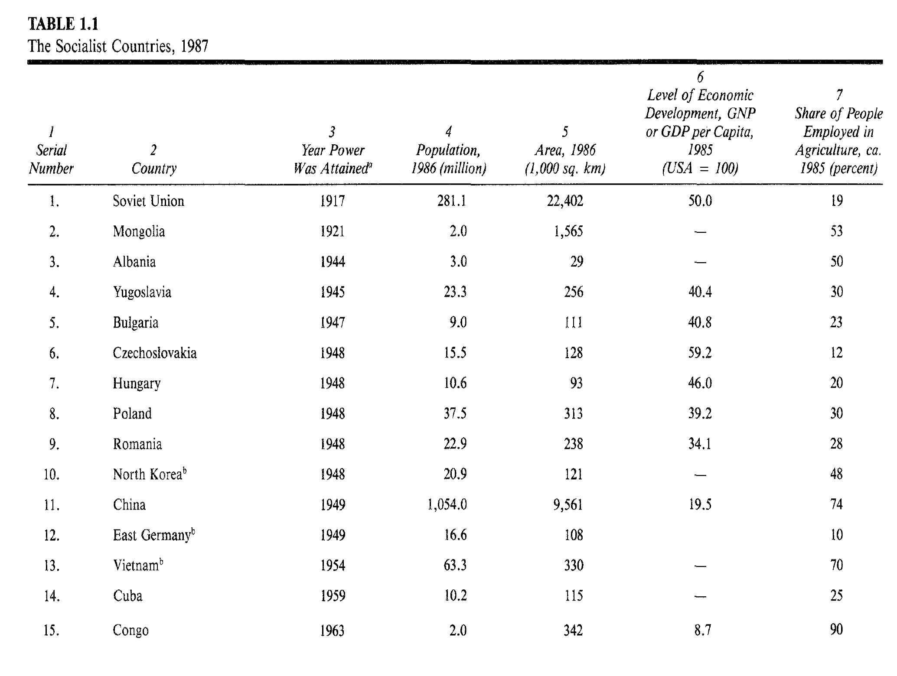

Slide 20
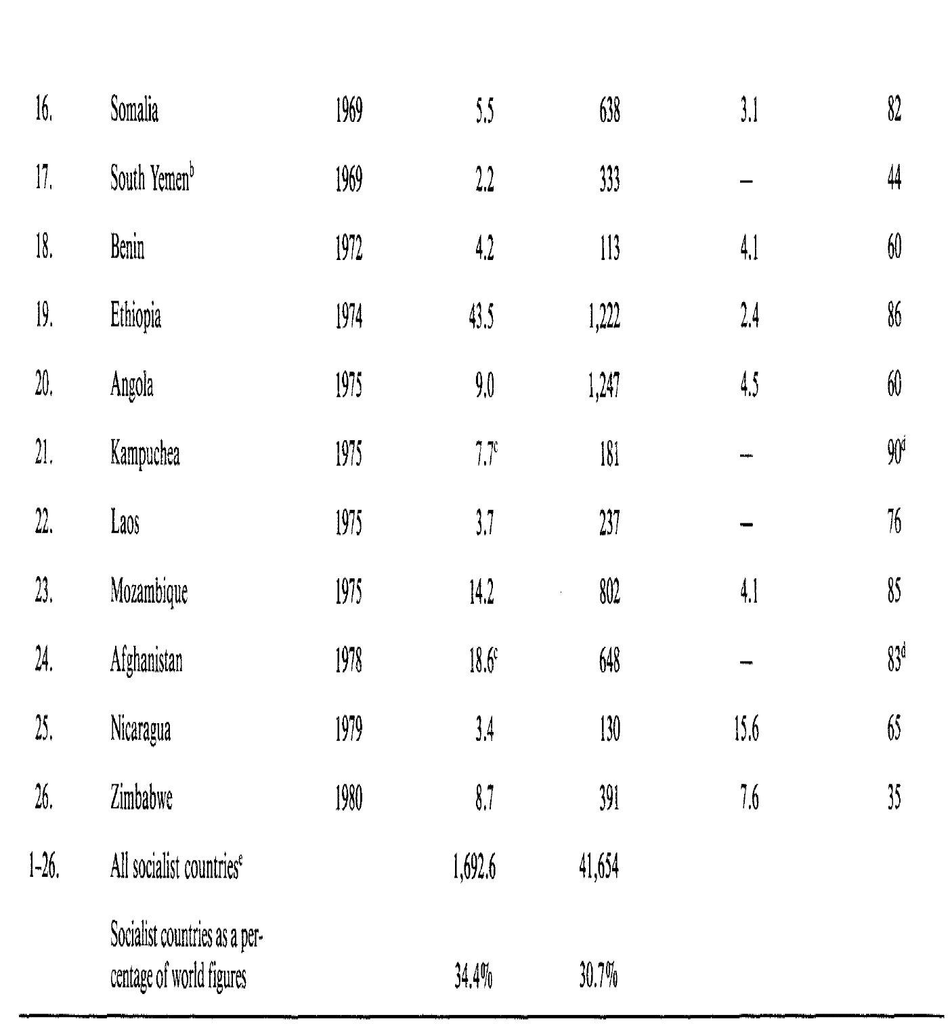

Slide 21
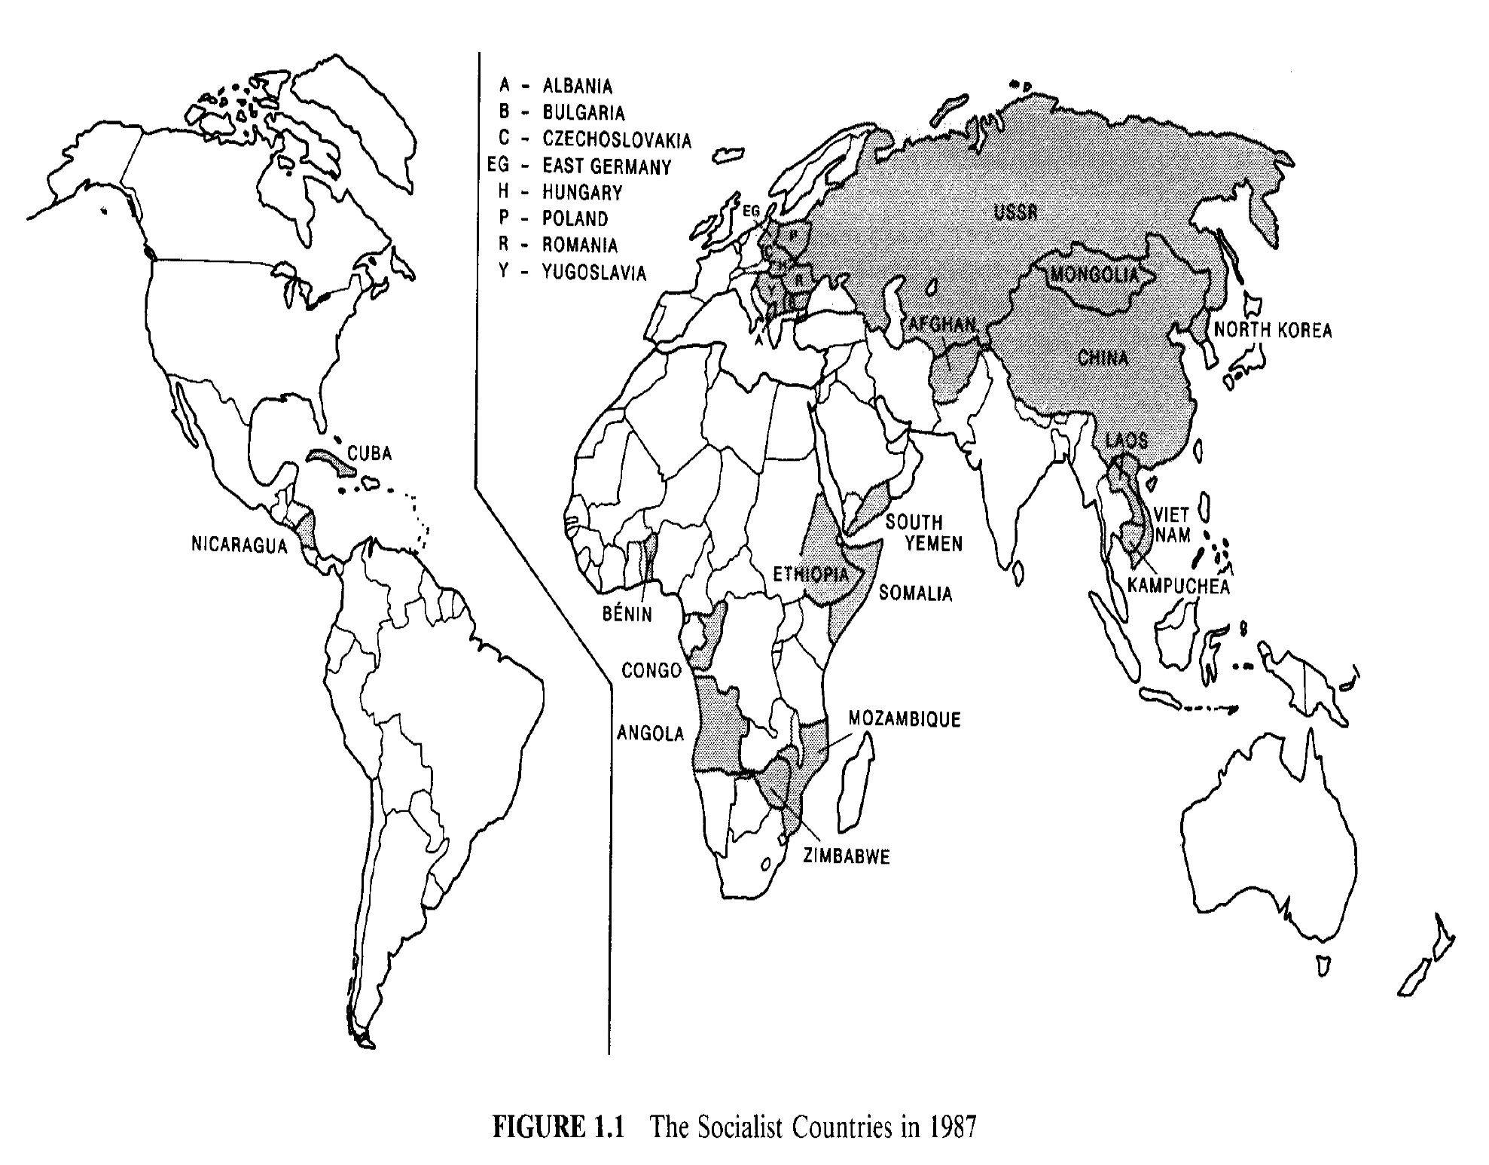

Slide 22
Undivided power of the Marxist-Leninist party
The key to understanding the socialist system is to examine the structure of power, which receives little or no attention in many comparative studies of economic systems.
In Kornai’s opinion, the characteristics of the power structure are precisely the source from which the chief regularities of the system can be deduced.

Slide 23
Undivided power of the Marxist-Leninist party
The fundamental institution in the power structure is the Communist Party
The socialist countries have a one party system in which no other party can operate.
Centralism prevails very strongly
Formally, the general secretary of the party is merely the one who executes the decisions of the central leadership.
In practice, enormous power is concentrated in his or her hands.

Slide 24
Undivided power of the Marxist-Leninist party
What has ultimately emerged in each case is a bureaucratic hierarchy that encompasses the whole of the party: instructions passed down from above must be carried out by the subordinates.
Elections are only formal.
In practice, the elected body is not picking the members of the leadership apparatus.
Instead, the apparatus is choosing those who will join the elected body at the next election and whom they in turn will elect as secretary.

Slide 25
Undivided power of the Marxist-Leninist party
Another key point: the various organizations in society each have an organizational monopoly in their own field.
There is one labor-union organization, one youth league, one women’s organization; the Academy of Sciences alone has the right to represent science.
This organizational monopoly makes it possible for the mass organizations to function concurrently as authorities.
Membership in the appropriate arts organization doubles as a permit to engage in that artistic activity professionally; without that membership it cannot be pursued.

Slide 26
Undivided power of the Marxist-Leninist party
The influence of the bureaucracy extends to every sphere of life.
The distinction between the state and private affairs becomes entirely blurred under the classical socialist system.
Influence of the bureaucracy extends to:
Culture
Religion
Life of the family
Relations of a household with its neighbors
How free time is spent
The choice of career and employment
Every economic transaction qualifies as a matter of state concern.

Slide 27
Dominant influence of the official ideology
The conviction that the socialist system is superior to the capitalist is one of the most important ingredients in the ideology.
The main assumption behind this is that socialist production relations offer more favorable conditions for developing the forces of production than capitalist production relations.

Slide 28
Dominant influence of the official ideology
Adherents make claims in the following areas.
Socialism can eliminate attributes of capitalism that erode efficiency.
Gross errors in the allocation of resources are caused by the anarchy of the market and the fluctuations in supply and demand
These problems can be overcome by planning, which does away with mass unemployment and the concomitant squandering of the most important production force of all, the human being.
Planning allows one to avoid crises of overproduction and the incalculable losses they involve.

Slide 29
Country | Year | State-owned Firms (GDP share)
Bulgaria | 1970 | 99.7
Cuba | 1988 | 95.9
Czechoslovakia | 1988 | 99.3
East Germany | 1988 | 96.4
Hungary | 1988 | 92.9
Poland | 1988 | 81.2
Romania | 1980 | 95.5
Vietnam | 1987 | 71.4
Yugoslavia | 1987 | 86.5
France | 1982 | 14.5
Greece | 1979 | 16.5
Italy | 1982 | 6.1
Spain | 1979 | 14.0
United Kingdom | 1978 | 4.1
United States | 1983 | 1.3
West Germany | 1982 | 10.7

Slide 30
Preponderance of bureaucratic coordination
Marx put forward very emphatically the following argument:
Capitalism produces a high degree of organization within the firm, but anarchy prevails in the market connecting the firms. This is inevitable as long as capitalist ownership remains.
Socialism (by eliminating both private ownership of the means of production and the anarchy of the market) allows organization on a national economic scale.
Marx reckoned that central allocation of social labor would be a very simple task.
The fact that the social relations between people, and along with them the relation of people to products, would no longer be obscured by the market’s "commodity fetishism" would make the task of allocation transparent and easy to survey.
Nor did it seem particularly hard to determine people's needs and demands.

Slide 31
Preponderance of bureaucratic coordination
Neither the writings of Marx nor of his followers before 1917 make any mention of the likely difficulties of planning on a national economic scale or, for instance, of the matter of collecting and processing the information needed for planning.
These thinkers deal frequently with the question of what kind of incentive will be needed in general to make people prepared to work, but the problem of the planners and plan implementing apparatus needing additional encouragement to do their special tasks is not raised.

Slide 32
Plan bargaining
There are many distorting political influences on information, but the main problem is the vast quantity of information required for bureaucratic coordination of the entire economy and social life.
Assembly and processing of that huge mass of information, and coordination based on this information, is too enormous and difficult a task to be undertaken efficiently through centralized planning and management.

Slide 33
Plan bargaining
When the plan is prepared, the higher authorities are presented not with alternative, variant plans, but with a single plan proposal that its creators attempt to defend as the sole feasible and therefore “inevitable” plan.
Planning involves a process of reconciliation on several levels, as if the planners were trying to solve bit by bit a vast system of simultaneous equations.
The only way it can be done is by repeated trial and error.
Even a powerful computer is only able to solve iteratively large systems of equations (and nothing, in fact, as large as those involved in the problem of planning).

Slide 34
Plan bargaining
Moreover, the time available for elaborating the plan is short; the collation process must be broken off arbitrarily before a fully reconciled plan has emerged.
So the plan is full of concealed inconsistencies. These reveal themselves one by one during the implementation.
Then come improvised modifications for the remaining period of the plan, or not even those, for sometimes the plan is adjusted retrospectively to the actual performance.
If one part of the plan or another is altered, corresponding alterations of the other parts should be made, since all the targets are interrelated. In fact, there is no time or energy to do so.

Slide 35
Quantity Drive
If an assignment is bafflingly complicated, nothing could be more natural than for those undertaking it to try its simplification for themselves.
One method applied widely is emphasis on the main tasks.
The plans initially contain several tens of thousands of figures on a national level, and the number continues to grow as and the number continues to grow as the plan aggregation proceeds downward.
So a peculiar "order of importance" develops among the figures in the plan, the most important of all being those for volume of production in aggregate value terms and broken down for the products rated most important.

Slide 36
Quantity Drive
There is a strong insistence on priority investment projects being completed on time and on punctual deliveries of all the materials, parts, and machinery they require.
Wage fund limits must be strictly observed. The incentives (bonuses, penalties) are tied to fulfillment of these priority tasks. But the concomitant is that the other planning directives become far easier to relegate, so that other tasks are neglected.

Slide 37
Quantity Drive
Thus, the intrinsic complexity of national planning inevitably causes simplifications in the planning process to emphasize priority production.
This emphasis on priority production primed planners in socialist economies to make a drive towards what was measurable in these areas: quantity.
Furthermore, starting with Marx, one of the major economic objectives under classical socialism is rapid growth.
Put these together, and you get what Kornai calls the “Quantity Drive”

Slide 38
Quantity Drive
The top leadership devises taut plans designed to force a rapid growth in production.
There is a constant effort through official propaganda and in day-to-day management and control to attain volume targets.
The compulsion to pursue this lopsided quantity drive comes not only from the instructions from above but from the urging of users of the products.
Meanwhile, the quantity drive has numerous harmful effects, such as neglect of product and insufficient care taken in expanding the product range.

Slide 39
Soft Budget Constraint
Another regularity across Socialist economies is a Soft Budget Constraint.
Across standard economies, Budget Constraints are relatively hard: in order to do one thing, one must avoid doing something else.
But, in socialist economies, the state owned enterprises don’t have their own private money and private constraints to bind them; they are in a constant state of negotiation with the higher bureaucracy.
Things that are normally hard constraints become “soft” if they can be continually renegotiated on a regular basis.

Slide 40
Soft Budget Constraint
What happens when a state-owned enterprise’s spending exceeds its official constraints?
And what happens if this is a regular, not an isolated occurrence?
Frequently, what can be observed to happen is an adjustment of the constraints:
Soft Subsidies
Soft Taxation
Soft Credit
Soft administrative pricing

Slide 41
Soft Budget Constraint
The end result of all of this is that actions that would normally be weeded out of economic activity can continue indefinitely.
Products that would normally be weeded out of economic activity can continue indefinitely.
Firms that would normally be weeded out of economic activity can continue indefinitely.
Soft Budget constraints eventually lead to an allocation of resources that is profoundly unresponsive to people’s desires, needs, and opportunities.

Slide 42
Weak Responsiveness to Prices
More generally, the internal “prices” in socialist systems therefore do not represent useful signals of desires, needs, and opportunities.
Furthermore, even when they do represent useful signals, there are limited incentives for firms to respond to them.
As a result, there is even more misallocation of resources.

Slide 43
Forced Growth
Furthermore, the Quality Drive we mentioned before has consistently been accompanied by national imperatives towards forced growth of the entire economy, as well as individual subsectors.
Five year plans have growth targets that must be reached.
Attaining this growth has required substantial costs in misallocated economic activity, but, even more so, in human lives.

Slide 44
Chronic Shortage Economy
All of the preceding features lead to one of the main commonalities across all socialist economies: chronic shortages.
A shortage doesn’t mean that prices are higher than you want.
It means that people are lining up waiting for goods that they can afford at current prices but which are not produced sufficiently to reduce wait times.
We experience occasional shortages in standard economies, and many more price increases that are erroneously called shortages.
But chronic shortages are a primary feature of socialist economies.

Slide 45
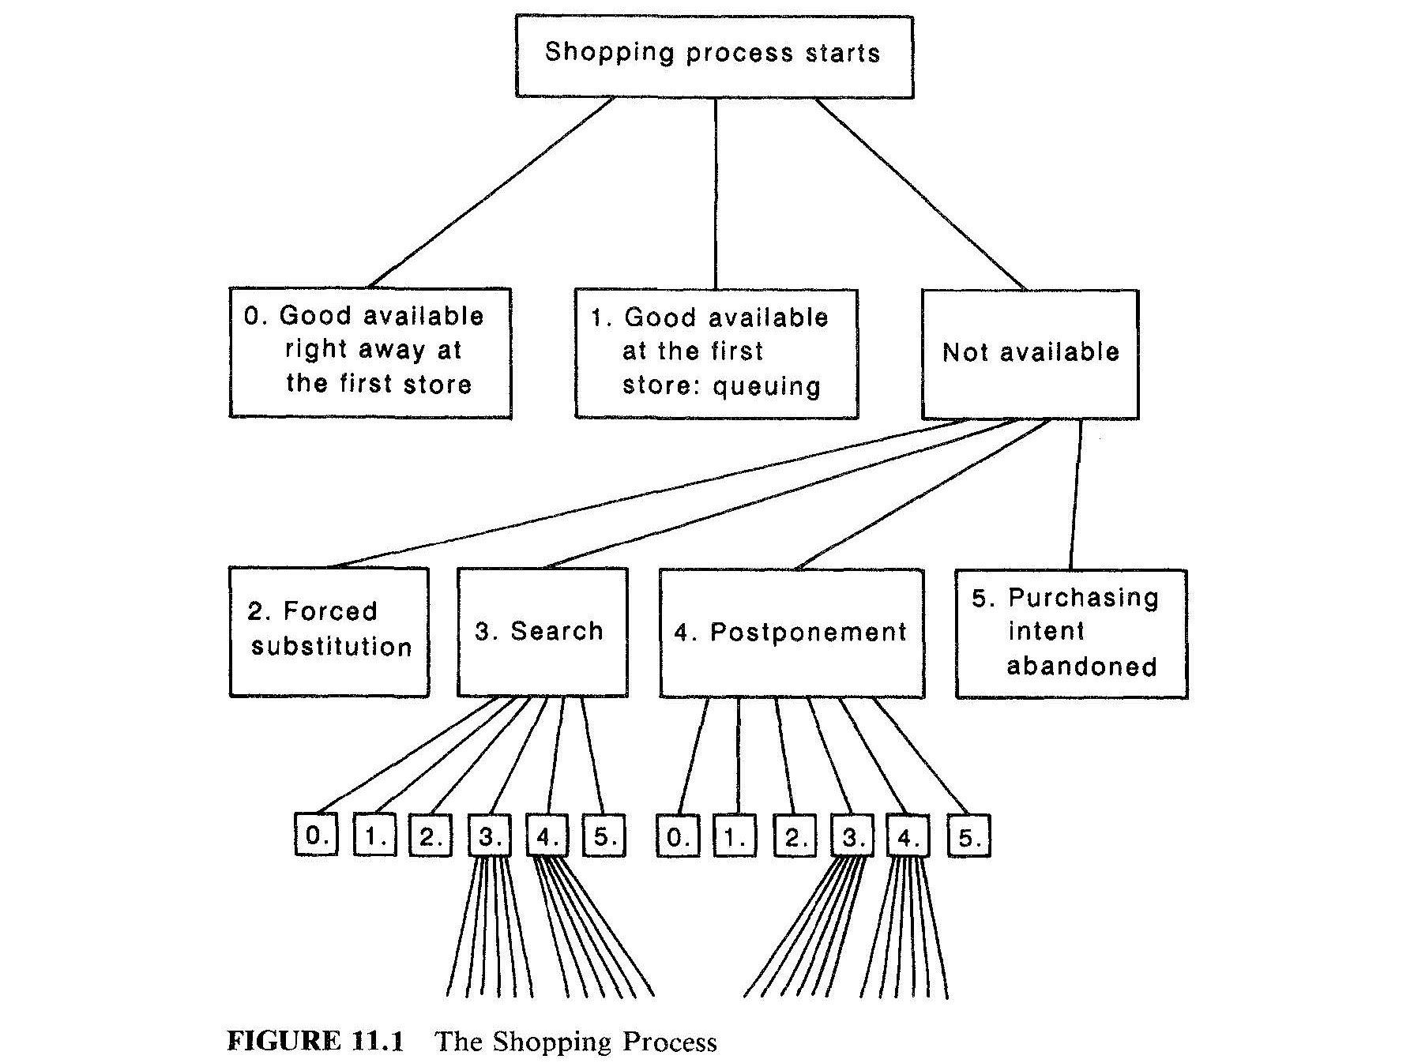

Slide 46
Waiting for Housing in the 1980s
Country | Average Length of Time on a Waiting List in years
Bulgaria | 5-20
Czechoslovakia | 6-8
East Germany | 3-4
Hungary | 4-6
Poland | 15-30
Soviet Union | 10-15

Slide 47
Length of Waiting List as Proportion of Number of Telephone Subscribers
County | 1971-75 | 1976-80 | 1981-85
Czechslovakia | 25.1 | 30.2 | 11.3
East Germany | 23.3 | 36.7
Hungary | 36.6 | 47.2 | 55.5
Poland | 33.6 | 45.7 | 57.1
Austria | 14.1 | 8.5 | 2.9
Belgium | 0.8 | 1.2 | 0.7
France | 13.1 | 7.9 | 0.9

Slide 48
Shortage Economy ➔ Hoarding of Inputs
The shortage phenomena and the uncertainty of obtaining supplies induce the buyer to hoarding, that is, to build up large input stocks.
Buyers make up for the absence of mobilizable producer reserve capacity by themselves producing the inputs they lack, if need be.
Firms in classical socialism therefore have a high degree of vertical integration.
Wherever possible an engineering works makes its own components and has its own foundry, and even its own building department, because it does not believe any outside firm will deliver a part or a casting, or provide a construction service on time or in an orderly way

Slide 49
Country | Average Input Stock per Average output Stock, 81-85
Bulgaria | 5.07
Czechoslovakia | 3.07
Hungary | 6.10
Poland | 4.49
Soviet Union | 3.16
Austria | 1.06
Australia | 1.36
Canada | 0.92
Finland | 1.92
West Germany | 0.71
Japan | 1.09
Norway | 1.10
Portugal | 1.66
Sweden | 0.81
United Kingdom | 1.02
United States | 1.02

Slide 50
Labor Shortage & unemployment on the job
As a result of the quality drive, the soft budget constraint, and the inefficiencies described above, labor also tends to be chronically in shortage.
But these same features mean that once an enterprise has obtained labor, it has an incentive to hoard it.
This means that labor, like input stocks, is chronically underemployed on the job.

Slide 51
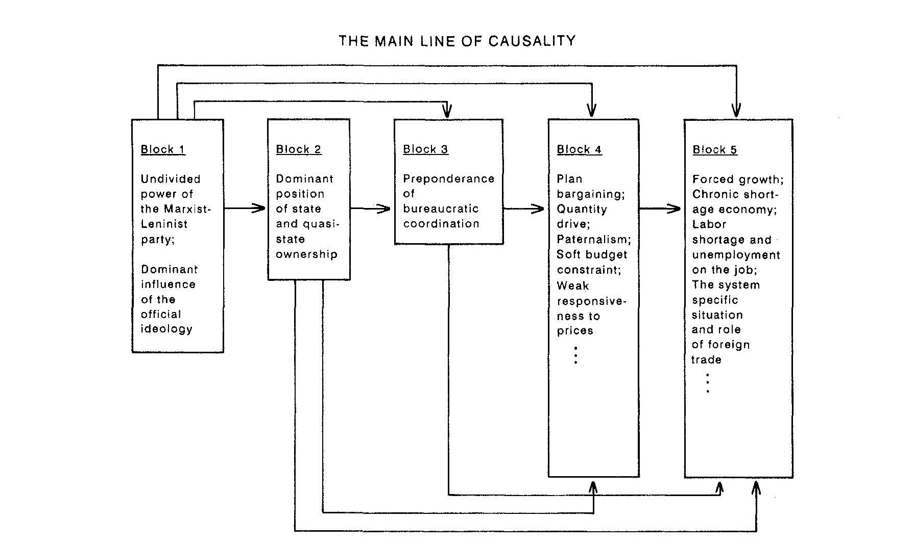

Slide 52
The experience of East Germany at opening
All of these effects combine to produce an economy in which people are chronically underemployed, enterprises are highly inefficient, and bureaucracies continually expand to try to fix these chronic problems without ever succeeding in doing so.
Thus, when East Germany separated from West Germany, it was at least West Germany’s equal in economic activity.
At the time of reunification 50 years later, demand for East German products disappeared overnight.
The end result of 50 years of different economic systems was the total rejection of the output of one of those systems

Slide 53
“For my conviction in any case is that ultimately, the countries living under the socialist system can only overcome the grave problems in their societies and economies if there is a change of system”
– Janos Kornai, The Socialist System

Slide 54
“If only it were all so simple! If only there were evil people somewhere insidiously committing evil deeds, and it were necessary only to separate them from the rest of us and destroy them. But the line dividing good and evil cuts through the heart of every human being. And who is willing to destroy a piece of his own heart?”
― Aleksandr Solzhenitsyn, The Gulag Archipelago 1918–1956

Slide 55
Summing Up
So, it looks like the main alternative to standard economies required predictable changes:
Diminishing the Church and all voluntary associations
Forcibly preventing individual economic activity and initiative
And it created predictable outcomes:
The resulting economic patterns did not achieve what standard economic patterns did for private goods, common resources, and public goods.
The associated destruction of voluntary associations lead to a diminishment in the quality of life, including its ethical quality.
How can we understand all of this in light of philosophy & theology?

Slide 56
Next Steps
The best candidate for helping us understand everything that we have learned in light of Catholic philosophy and theology is Thomism
Realist, empirically focused
Very general
Basis of much of Catholic Social Teaching
In order to try to understand Thomistic Philosophy and Theology, we have to understand how St. Thomas argued.
There is no better place to start than the very beginning. . .

