Slide 1
Economy, Divine and Human
Professor Kirk Doran
Lecture 1: Wednesday, August 23, 2023
Introduction

Slide 2
Welcome!
Welcome to Economy, Divine and Human
I’m Professor Kirk Doran, Henkels Family Collegiate Chair and Associate Professor of Economics
Our wonderful TA, Antônio Lemos, is a Ph.D. student in Theology and will help with all of our grading this semester.
Welcome!! We are looking forward to an awesome semester together.
Let’s start with a prayer.

Slide 3
Why this course?
This class counts for Economics, it counts for Theology, and it counts for Catholicism in the Disciplines!

Slide 4
Why this course?
This class counts for Economics, it counts for Theology, and it counts for Catholicism in the Disciplines!
What are we trying to understand that could make the course count for so many requirements?

Slide 5
Why this course?
This class counts for Economics, it counts for Theology, and it counts for Catholicism in the Disciplines!
What are we trying to understand that could make the course count for so many requirements?
Well, ask the internet about Demand curves, and you get a lot of consistent stuff.

Slide 6
Why this course?
This class counts for Economics, it counts for Theology, and it counts for Catholicism in the Disciplines!
What are we trying to understand that could make the course count for so many requirements?
Well, ask the internet about Demand curves, and you get a lot of consistent stuff.
Ask the internet about Catholic teaching on the Incarnation, and you get a lot of consistent stuff.

Slide 7
Why this course?
This class counts for Economics, it counts for Theology, and it counts for Catholicism in the Disciplines!
What are we trying to understand that could make the course count for so many requirements?
Well, ask the internet about Demand curves, and you get a lot of consistent stuff.
Ask the internet about Catholic teaching on the Incarnation, and you get a lot of consistent stuff.
But, ask the internet about Catholicism and economics, and you get. .

Slide 9


Slide 10
Authoritative sources?
When you try to solve this problem by going to authoritative sources, such as the set of Social Encyclicals, letters which Popes have sent out to the Bishops, the Church, and the world periodically since 1891, we get to this problem. . .

Slide 11
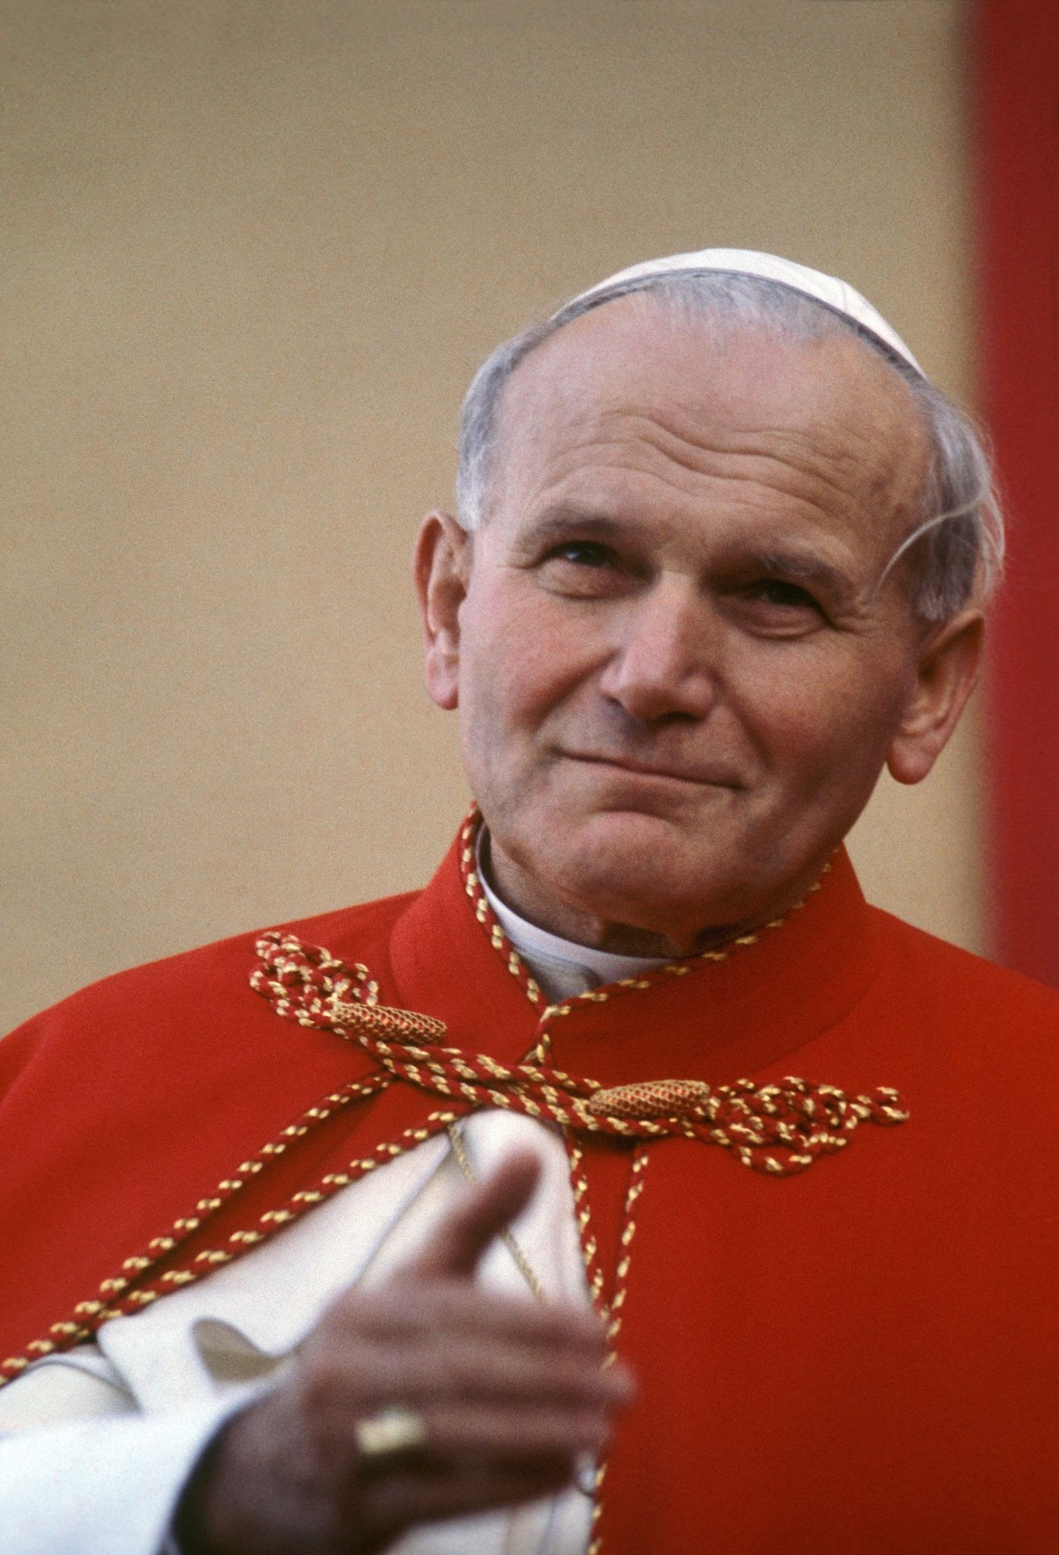
The Encyclicals are hard to read
In order to be genuine, development must be achieved within the framework of solidarity and freedom, without ever sacrificing either of them under whatever pretext. The moral character of development and its necessary promotion are emphasized when the most rigorous respect is given to all the demands deriving from the order of truth and good proper to the human person. Furthermore the Christian who is taught to see that man is the image of God, called to share in the truth and the good which is God himself, does not understand a commitment to development and its application which excludes regard and respect for the unique dignity of this "image.“ – John Paul II, Sol.Rei.Soc., 33

Slide 12
More questions than answers
What do we mean by development?
What do we mean by freedom?
What do we mean by solidarity?
Who is God?
Who is Man?
Why is he in the Image of God?
What is the Church?
What is the order of truth and good?

Slide 13
How can we contribute to this debate?
People read writing like this, and they start to argue.
When we attempt to engage this conversation, we find that we’re entering an ongoing debate, with established sides.
Furthermore, even if we’re people of good will, we inevitably find that this is an intractable debate, and hence hard to contribute to.
To figure out how we could improve the conversation, we must ask:
Why do intractable debates typically happen?

Slide 14
How can we contribute to this debate?
“Most debates depend on an attempt (by one or both sides) at over-simplification; and I do not suppose that this debate is an exception.” – J.R.R. Tolkien “On Fairy Stories”

Slide 15
How can we contribute to this debate?
“Most debates depend on an attempt (by one or both sides) at over-simplification; and I do not suppose that this debate is an exception.” – J.R.R. Tolkien “On Fairy Stories”
Why might people have a tendency to over-simplify when talking about the Church and the Economy?

Slide 16
How can we contribute to this debate?
“Most debates depend on an attempt (by one or both sides) at over-simplification; and I do not suppose that this debate is an exception.” – J.R.R. Tolkien “On Fairy Stories”
Why might people have a tendency to over-simplify when talking about the Church and the Economy?
Well, imagine that you were trying to speak about something subtle with someone who only speaks another language.

Slide 17
How can we contribute to this debate?
“Most debates depend on an attempt (by one or both sides) at over-simplification; and I do not suppose that this debate is an exception.” – J.R.R. Tolkien “On Fairy Stories”
Why might people have a tendency to over-simplify when talking about the Church and the Economy?
Well, imagine that you were trying to speak about something subtle with someone who only speaks another language.
What will each of you have to do with complicated expressions?

Slide 18
How can we contribute to this debate?
“Most debates depend on an attempt (by one or both sides) at over-simplification; and I do not suppose that this debate is an exception.” – J.R.R. Tolkien “On Fairy Stories”
Why might people have a tendency to over-simplify when talking about the Church and the Economy?
Well, imagine that you were trying to speak about something subtle with someone who only speaks another language.
What will each of you have to do with complicated expressions?
Answer: Simplify!

Slide 19
How can we contribute to this debate?
Well, Economists have our own languages, and the Church has its languages, and they are all different from each other.

Slide 20
How can we contribute to this debate?
Well, Economists have our own languages, and the Church has its languages, and they are all different from each other.
Rarely do we speak at least one language on both sides.

Slide 21
How can we contribute to this debate?
Well, Economists have our own languages, and the Church has its languages, and they are all different from each other.
Rarely do we speak at least one language on both sides.
So, really, we’re forced to over-simplify, because subtlety is impossible when we are not speaking the same language.

Slide 22
How can we contribute to this debate?
Well, Economists have our own languages, and the Church has its languages, and they are all different from each other.
Rarely do we speak at least one language on both sides.
So, really, we’re forced to over-simplify, because subtlety is impossible when we are not speaking the same language.
The purpose of this course is to get us all speaking the same language.

Slide 23
How can we contribute to this debate?
Well, Economists have our own languages, and the Church has its languages, and they are all different from each other.
Rarely do we speak at least one language on both sides.
So, really, we’re forced to over-simplify, because subtlety is impossible when we are not speaking the same language.
The purpose of this course is to get us all speaking the same language.
I have intentionally chosen what I take to be the sources which will give us the broadest possible latitude for what we can discuss while still speaking the same language:

Slide 24
Sources: Four main sources
(1) The foundational principles of empirical (not theoretical) economics

Slide 25
Sources: Four main sources
(1) The foundational principles of empirical (not theoretical) economics
(2) The foundational principles of Thomistic philosophy and theology

Slide 26
Sources: Four main sources
(1) The foundational principles of empirical (not theoretical) economics
(2) The foundational principles of Thomistic philosophy and theology
(3) The broadest cultural/religious/psychological histories of the standard economy and its longest-lasting contender, classical socialism

Slide 27
Sources: Four main sources
(1) The foundational principles of empirical (not theoretical) economics
(2) The foundational principles of Thomistic philosophy and theology
(3) The broadest cultural/religious/psychological histories of the standard economy and its longest-lasting contender, classical socialism
(4) The most important documents of Catholic Social Teaching (CST)

Slide 28
Principle of Interpretation
Why these particular sources?

Slide 29
Principle of Interpretation
Why these particular sources? Because I think they are both very general and very clear.

Slide 30
Principle of Interpretation
Why these particular sources? Because I think they are both very general and very clear.
“we may take examples from those things that are manifest to illuminate those things which are obscure, bringing principles which are certain to bear on our doubts concerning those things which are uncertain”
  -- Saint Augustine of Hippo, De Doctrina Christiana

Slide 31
Principle of Interpretation
Why these particular sources? Because I think they are both very general and very clear.
“we may take examples from those things that are manifest to illuminate those things which are obscure, bringing principles which are certain to bear on our doubts concerning those things which are uncertain”
  -- Saint Augustine of Hippo, De Doctrina Christiana
In other words. . . Let the clear interpret the unclear!

Slide 32
Sources: Four main sources
So, let’s go through our four main sources one at a time, and try to understand why these are the four relevant sources for our aim of better understanding a synthesis and intersection of Catholic teaching and economics.
We’ll start by trying to understand what Economics is!

Slide 33
Sources: Four main sources
So, let’s go through our four main sources one at a time, and try to understand why these are the four relevant sources for our aim of better understanding a synthesis and intersection of Catholic teaching and economics.
We’ll start by trying to understand what Economics is!
Two thirds of you have an economics background, but I want us to understand economics in a very particular (and very modern) way.

Slide 34
What is the Discipline of Economics?
Suppose that you attended a Notre Dame football game.

Slide 35
What is the Discipline of Economics?
Suppose that you attended a Notre Dame football game. No, not American football, soccer!

Slide 36
What is the Discipline of Economics?
Suppose that you attended a Notre Dame football game. No, not American football, soccer!
You overheard someone watching the game, saying: “wow, it’s amazing how much fun kids can have just running around and kicking the ball to each other. Maybe I’ll go and join them!”

Slide 37
What is the Discipline of Economics?
You’d be pretty surprised. After all, they aren’t just a bunch of kids enjoying kicking the ball whenever it gets near them; they are two well-defined teams, each ordered towards the end of winning a game with well-defined rules.

Slide 38
What is the Discipline of Economics?
You’d be pretty surprised. After all, they aren’t just a bunch of kids enjoying kicking the ball whenever it gets near them; they are two well-defined teams, each ordered towards the end of winning a game with well-defined rules.
But, if this was the first time you saw a soccer game, you might make the same mistake. If no one told you that there was such a thing as a soccer game, or that soccer games had rules, you couldn’t discern both facts right away just from glancing at one group of kids running around on a field.

Slide 39
What is the Discipline of Economics?
You’d be pretty surprised. After all, they aren’t just a bunch of kids enjoying kicking the ball whenever it gets near them; they are two well-defined teams, each ordered towards the end of winning a game with well-defined rules.
But, if this was the first time you saw a soccer game, you might make the same mistake. If no one told you that there was such a thing as a soccer game, or that soccer games had rules, you couldn’t discern both facts right away just from glancing at one group of kids running around on a field.
Rather, you could eventually discern both facts by watching enough games, observing carefully, creatively “testing” assumptions about the existence and nature of potential rules, and discussing your hypotheses and conclusions with others on a similar mission of intellectual curiosity and empirical observation.

Slide 40
What is the Discipline of Economics?
This is what economists have done with the economic order. Over the last two hundred years, economists have steadily learned some of the laws or rules of economies, and of human interactions subject to scarcity in general, through the same process described above.

Slide 41
What is the Discipline of Economics?
This is what economists have done with the economic order. Over the last two hundred years, economists have steadily learned some of the laws or rules of economies, and of human interactions subject to scarcity in general, through the same process described above.
There exist empirical phenomena that are now well enough understood to count as principles of economics

Slide 42
Source 1: Empirical Economics
Economics is often called the science of scarcity
What is scarcity?
Scarcity ➔ tradeoffs
Tradeoffs ➔ regular patterns in the world around us
These patterns predictably vary according to how scarcity does or does not impinge upon the goods that make them up.
We will cover the four patterns with the most general and consistent empirical verification ➔ clarity when we intersect economics with theology and CST

Slide 43
Where does Economics end?
Now, to return to our soccer analogy: suppose economists (or, in the case of soccer, soccerists) were asked: “who invented these rules, and why do they exist?”
They might easily answer: “no one invented them.”
Or: “this is a meaningless question”.
It is impossible that, acting qua soccerists, they would ever realize who the author of the rules was, and what their purpose was; this would require a different line of inquiry.

Slide 44
What is the Discipline of Theology?
This is where Theology comes in. Theologians primarily use the data in Scripture and Tradition that God has divinely revealed to teach us who He is, who we are, and to help us understand His creation in the deepest and most holistic way possible.

Slide 45
What is the Discipline of Theology?
This is where Theology comes in. Theologians primarily use the data in Scripture and Tradition that God has divinely revealed to teach us who He is, who we are, and to help us understand His creation in the deepest and most holistic way possible.
Then, they try to better understand this data first of all through good philosophy, which uses the data of human experience and logic to grasp the essence of things like freedom, human nature, causality, beauty, happiness, etc, and to understand the meaning and beauty of the order in the Universe.

Slide 46
What is the Discipline of Theology?
But theologians can make use of any true knowledge of God and the world, including the knowledge given by modern economics, to better understand divine revelation.
A guiding principle in this endeavor is that truth is one, and so contradictory ideas cannot both be true.

Slide 47
What is the Discipline of Theology?
If an idea that has been divinely revealed turns out to be contradictory to an idea that comes from a branch of human knowledge, Catholics believe that the divinely revealed idea must be true, and the contradictory idea must be false.
But, they also believe that every true idea attained by human inquiry will not be in conflict with what God has divinely revealed, but will instead be of great help in more clearly understanding divine revelation.
And, the ideas that are rooted in divine revelation are of great use to all the branches of human inquiry, setting them within their proper context, and providing a more fundamental explanation for why things are the way they are in the world.

Slide 48
What Theology do we need?
To be a useful place of intersection with Economics, we need a theology which is based on the kind of philosophy which could possibly intersect with economics.
A philosophy which takes experience and empirical observation very seriously.
And yet a philosophy that can be used to express a whole host of Catholic truths.

Slide 49
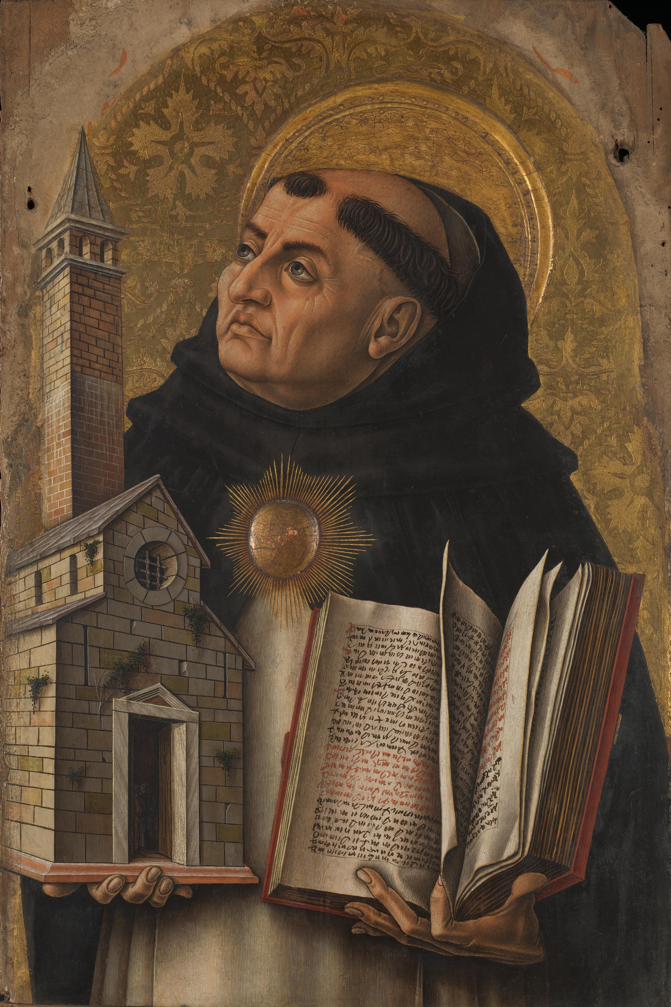
Source 2: Thomistic Philosophy and Theology
Thomas Aquinas OP (Tommaso d'Aquino, lit. 'Thomas of Aquino'; 1225 – 7 March 1274)
He was a realist (i.e. unlike skeptics, he believed that the world can be known as it is).
This realism made his philosophy critically open to experience and empirical reality.
He held the principle of non-contradiction
He tried to exhaustively summarize in one coherent philosophical language a Catholic understanding of God, the Universe, Man, Social relations, the Incarnation, the Church, Heaven.

Slide 50
Source 2: Thomistic Philosophy and Theology
Furthermore, much of the first fifty years of modern Catholic Social Teaching (CST), starting in 1891, used language and ideas derived from Thomistic philosophy and theology.
Putting this all together, by learning some Thomistic Philosophy and Theology, we’ll have a flexible language, already used by the Church in its CST, that is designed to be very general, very open to empirical experience, and very consonant with the perennial truths of the Faith.
So, it’s an ideal source for a meeting place between (especially empirical) economics principles and the Church.

Slide 51
The contingencies of history
But, wait a minute!
If we want to understand perennial truths about intrinsic connections between Catholicism and economics, we run into an immediate difficulty.
Both have changed over time!
The Church’s teaching has developed over time, with the deepest truths never contradicting each other, but with many surface level instantiations thoroughly changing (J.H. Newman)
The economy, and our understanding of it, have definitely changed!

Slide 52
Perennial truths of economics?
Are there any perennial truths of economics? If so, what would a perennial truth look like? How would we identify a perennial truth?

Slide 53
Limitations on Possibilities: road example
It’s going to turn out that perennial truths of economics are best understood as limitations on the set of patterns that could possibly occur.

Slide 54
Limitations on Possibilities: road example
It’s going to turn out that perennial truths of economics are best understood as limitations on the set of patterns that could possibly occur.
To understand this, first think about an analogous example: possible patterns on (relatively highspeed) roads.

Slide 55
Limitations on Possibilities: road example
It’s going to turn out that perennial truths of economics are best understood as limitations on the set of patterns that could possibly occur.
To understand this, first think about an analogous example: possible patterns on (relatively highspeed) roads.
If the society doesn’t involve total wreckage and mayhem on its roads, then there are only two possible patterns which will emerge:
  Pattern 1: people’s default is to drive on their right
  Pattern 2: people’s default is to drive on their left

Slide 56
Limitations on Possibilities: road example
There are no other possible patterns other than these!
Given human nature and the nature of lines on a plane, any other pattern would result in many easily preventable deaths.
So, if the society has a stable pattern of frequent highspeed auto traffic on its roads, we can be sure it will have settled into one of these two patterns.
And indeed, that’s what we see: 165 countries RHT; 75 countries LHT
BUT, there’s a big if there.

Slide 57
Limitations on Possibilities: road example
There are no other possible patterns other than these!
Given human nature and the nature of lines on a plane, any other pattern would result in many easily preventable deaths.
So, if the society has a stable pattern of frequent highspeed auto traffic on its roads, we can be sure it will have settled into one of these two patterns.
And indeed, that’s what we see: 165 countries RHT; 75 countries LHT
BUT, there’s a big if there.

Slide 58
Limitations on Possibilities: road example
There are lots of things that have to happen in order for a society to have a stable pattern of frequent highspeed auto traffic on its roads.
The society has to have accumulated many inventions, it needs to have decided to invest in roads smooth enough and durable enough and long enough to bear fast moving cars, and the individuals need to have invested in the cars as well.

Slide 59
Limitations on Possibilities: road example
The two possible patterns described above are the only patterns possible for fast cars on such roads, given the reality of the universal aspects of human nature (such as physicality, limitations on cognition, etc) and the nature of lines on a plane.
BUT, that doesn’t mean that the ancillary circumstances necessary for a self-sustaining society to form such that one of those patterns is stably instantiated within it are automatic.

Slide 60
Limitations on Possibilities: road example
To belabor the point:
Before the modern era, the traffic wasn’t fast enough to force an equilibrium pattern to always emerge.
Absent the necessary conditions in the “if”, we didn’t have the patterns:
For example, in 1827 in Paris, "The coachmen have no established rule by which they drive on the right or left of the road, but they cross and jostle one another without ceremony."
In 2023, Mackinaw Island still doesn’t have such traffic!

Slide 61
Analogy to Economics
It’s going to turn out that the most perennial, important patterns in economics are like that.
They are conditional restrictions on what could possibly occur.

Slide 62
Analogy to Economics
So, as we will learn:
There is no way to grow without knowledge, that necessity is not up for grabs, but a stable equilibrium in which society regularly produces knowledge and grows as a result of it is still a culturally contingent thing.
There is no way to exchange large numbers of goods among disaggregated participants each looking out for their own commutative justice without producing market equilibria, but that doesn’t mean that the preconditions in law, culture, and psychology for stably maintaining such exchange will always be met.

Slide 63
Need a third source!
To understand this, and to see how the Church and Church teaching may have played a role in which stable economic patterns emerged, we need to study the history of people’s psychology, culture, and sociology.
Since there are two (relatively) stable equilibria that have ever occurred for large numbers of people (what we’ll call “standard” economies, and classical socialism, or communism), we’ll have to study the history of both types of economies.

Slide 64

Source 3: Cultural Histories
“Standard” Economies:
We’ll learn a lot from the work of Joseph Henrich (ND ’91), chair of the Department of Human Evolutionary Biology at Harvard University

Slide 65
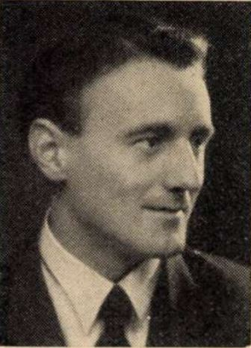
Source 3: Cultural Histories
“Classical Socialist” Economies:
We’ll learn a lot from the work of Janos Kornai, an economist who analyzed how communist economies functioned using data from behind the Iron curtain, before coming to Harvard University and sharing with the West.

Slide 66
Source 4: Key Encyclicals!
Finally, we will bring all this together to understand perennial truths of the faith as they were applied to economic problems throughout history: the church’s tradition of social teaching!

Slide 67
Source 4: Key Encyclicals!
Finally, we will bring all this together to understand perennial truths of the faith as they were applied to economic problems throughout history: the church’s tradition of social teaching!
By any measure, it is a prodigious tradition. Beginning in 1878 with the election of Leo, popes have issued more than 250 encyclicals and other teaching letters. About half are related, broadly, to issues of social thought and doctrine.

Slide 68
Source 4: Key Encyclicals!
Whereas in doctrinal theology proper, the revealed data are unfolded with more clarity and richness gradually, as the Church reflects upon the deposit of faith, in social doctrine the teachings include applications of principles to the contingencies of societies.

Slide 69
Source 4: Key Encyclicals!
Whereas in doctrinal theology proper, the revealed data are unfolded with more clarity and richness gradually, as the Church reflects upon the deposit of faith, in social doctrine the teachings include applications of principles to the contingencies of societies.
This makes social doctrine very interesting.

Slide 70
Source 4: Key Encyclicals!
Whereas in doctrinal theology proper, the revealed data are unfolded with more clarity and richness gradually, as the Church reflects upon the deposit of faith, in social doctrine the teachings include applications of principles to the contingencies of societies.
This makes social doctrine very interesting.
By the same token, it can be distorted through ideologies, political policies and various kinds of jargon used by political parties.
Using new empirical research and our work from the first half of the course, we will avoid this fate, and contribute well to the debate!!!

Slide 71
Things you’ll know by the end
Some important economic principles!
The history of the instantiation of those principles around the world, and the relation of the Catholic Church to that history
Some important principles of Thomistic philosophy and theology
How to read Catholic Social Teaching in light of all of the above – and apply it to your own lives!!!

Slide 72
This course
You can find the key materials on the course Canvas page:
  Modules (these will serve as your course calendar)
  Readings
  Slides from Lecture
Let’s check out the Canvas page
Syllabus

Slide 73
Work Output in this course
Extensive Reading: approximately 4 hours per week.
Half-page Reflections/Responses: Should take 1 hour per week.
In-class Midterm: Wednesday, October 11
4 page Essay: Due Tuesday, November 22
Final Exam
Studying for the midterm and final and doing a good job on the 4 page Essay should add a total of about 34 hours of work to the course, or about 2 hours per week over the semester.

Slide 74
Grading Scale
A: 92%-100%
A-: 89%-91.9%
B+: 86%-88.9%
B: 82%-85.9%
B-: 79%-81.9%
C+: 76%-78.9%
C: 72%-75.9%
C-: 69%-71.9%

Slide 75
Upcoming Dates
Wednesday, August 23: | Introduction
Monday, August 28: | Demand, Supply, and Market Equilibrium
Wednesday, August 30: | Diminishing Marginal Product and Labor Markets
Friday, September 1: | Reflection Due
Monday, September 4: | Non-Rivalness, non-Excludability, and Markets
Wednesday, September 6: | Knowledge and increasing returns and growth
Friday, September 8: | Reflection Due
Monday, September 11: | How general are economic patterns?
Wednesday, September 13: | The Evolution of Societies, Cultures and Psychologies
Friday, September 15: | Response Due
Monday, September 18: | The Catholic Church, Family formation, and Psychology
Wednesday, September 20: | The Catholic Church, New Institutions, and the Market
Friday, September 22: | Response Due
Monday, September 25: | Against the Church and the Market: Classical Socialism
Wednesday, September 27: | Who is God?
Friday, September 29: | Response Due
Monday, October 2: | What is Order?
Wednesday, October 4: | Who is Man?
Friday, October 6: | Response Due
Monday, October 9: | Social Ontology
Wednesday, October 11: | In-class Midterm

Slide 76
Some Raw materials of the above slides:
Pursuing the Common Good: How Solidarity and Subsidiarity Can Work Together Pontifical Academy of Social Sciences, Acta 14, Vatican City 2008. www.pass.va/content/dam/scienzesociali/pdf/acta14/acta14-hittinger.pdf
Dr. Margaret Blume Freddoso: conversations and notes.
John Paul II: Sol.Rei.Soc., 33
J.R.R. Tolkien: On Fairy Stories
Saint Augustine of Hippo: De Doctrina Christiana
https://en.wikipedia.org/wiki/Left-_and_right-hand_traffic

